Slide 1
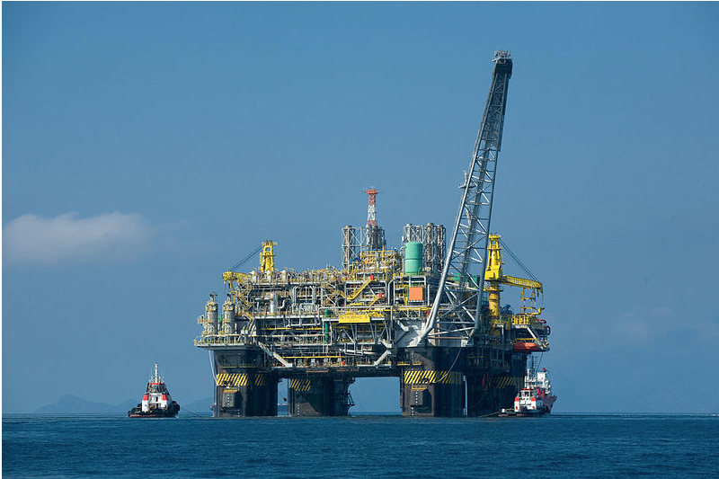
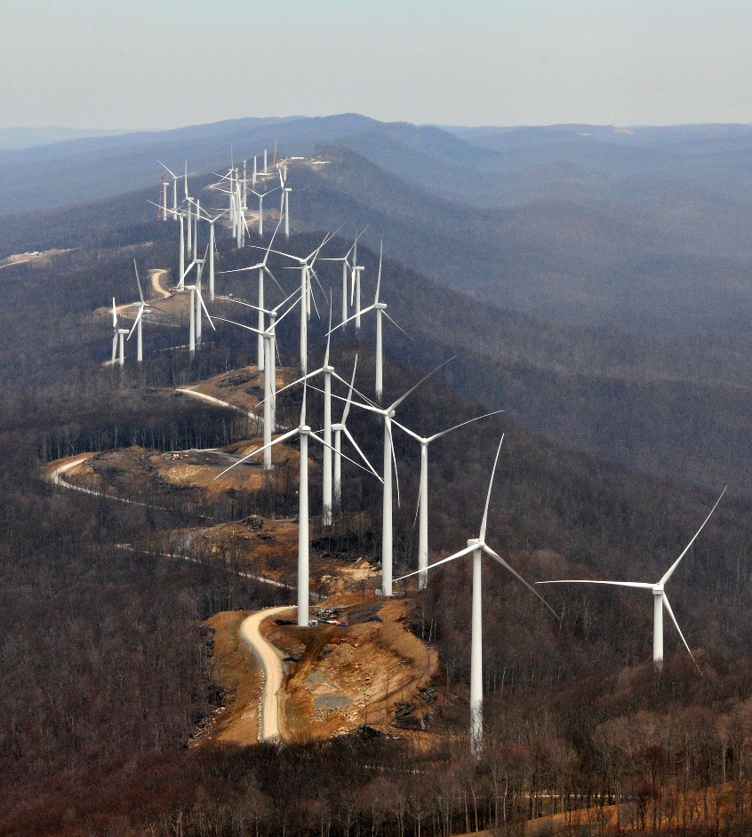
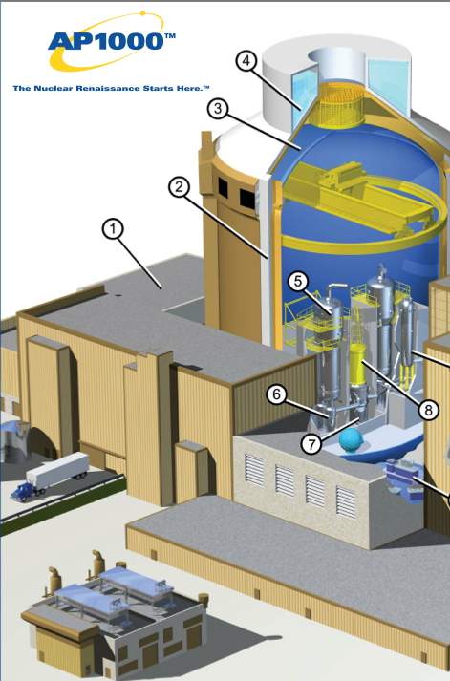
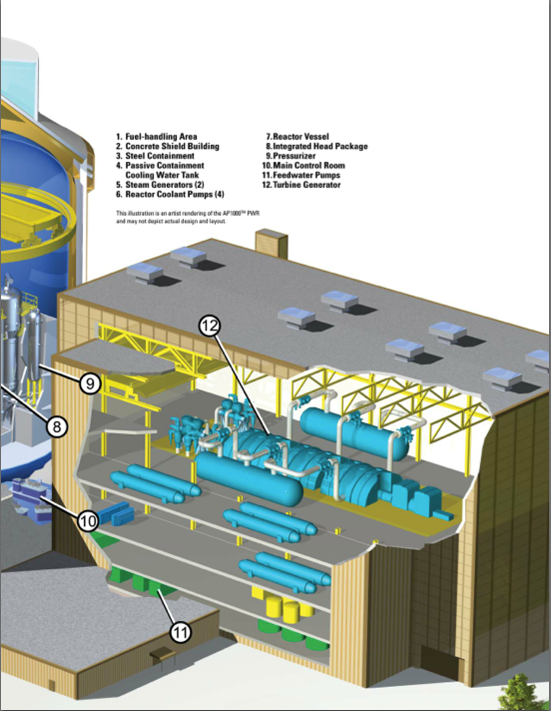
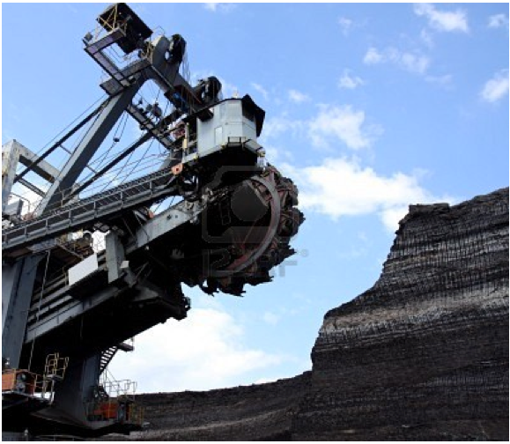
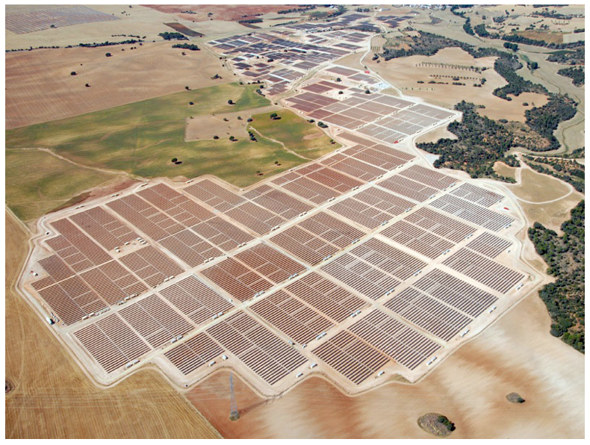
Electricity Generation, Transmission and Distribution: what does
the future hold?
Bryan Leyland, MSc, FIEE(rtd), FIMechE, FIPENZ. Leyland Consultants

Slide 2
Generation
Future options are:
fossil fuels
nuclear
hydro
new renewables
wind solar, tidal, wave etc

Slide 3
Fossil fuels
Every year peak oil moves further into the future
Shale gas has transformed the industry
The clathrate (methane ice) resource is immense
There are huge resources of coal
clean coal stations emit CO2 and water
CO2 enhances plant growth and benefits agriculture

Slide 4
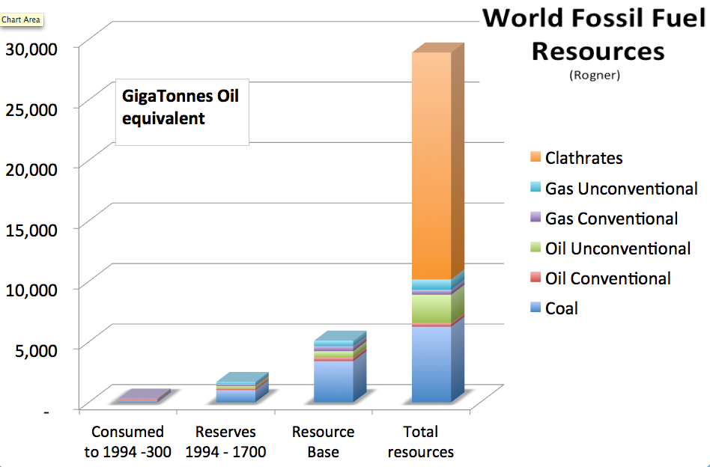
Fossil fuel resource is huge!

Slide 5
Nuclear Energy
Nuclear power could supply all the energy we need for more than 500 years
Uranium resources
proven:~80 years supply
expected:~250 years supply
1000+ years with breeder reactors!
Energy from thorium
3 times as abundant as uranium >750 years supply

Slide 6
Death
rates
Regulated
levels are
~1 mSv
2000 mSv
is safe!
Safe
Dangerous
Fatal

Slide 7
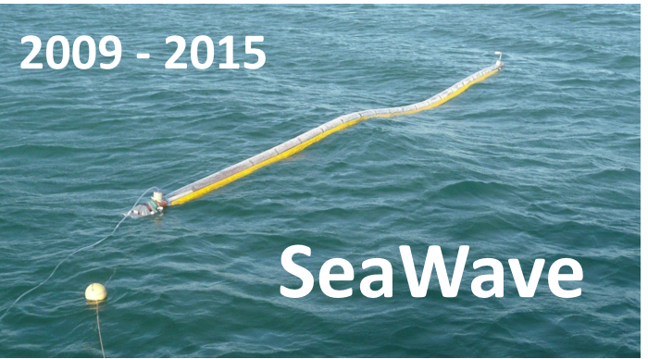
Hydro, Geothermal and Renewables
Hydro and Geothermal
will continue to provide power when it is needed at low cost
Wind and Solar
intermittent and expensive
impose high costs on the system
backup and transmission
Tidal, Wave etc
nowhere near commercial viability
SeaWave may succeed
and make all other wave power devices obsolete overnight

Slide 8
Transmission in New Zealand
Several years ago it was suggested that one pole of the DC link should be extended to Auckland
if it had gone ahead, the $900 million 400 kV line would not have been needed
15 years ago the then CEO of Transpower decided that distributed generation was going to make transmission systems obsolete
it didn’t happen and the catchup was difficult and expensive
In many countries distributed generation in the form of subsidised solar and wind power is progressing rapidly
this requires lot of new transmission
we can conclude that distributed generation needs even more transmission!

Slide 9
DC transmission
Advantages of DC for point to point transmission
two conductors instead of three
no skin effect – lower losses, higher current and larger conductors
no reactive power problems
asynchronous connection
Disadvantages are:
high cost of terminal equipment
problems with multi terminal systems

Slide 10
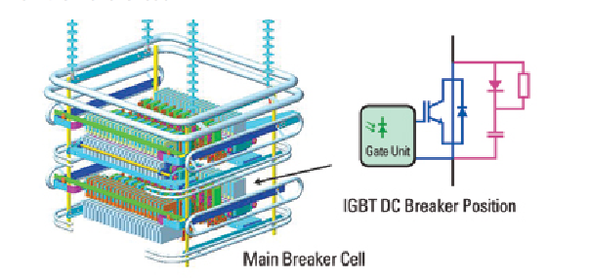
Future of DC transmission
The cost of terminal equipment is steadily decreasing
The cost of underground DC cables is steadily decreasing
DC circuit breakers are now available
DC will supersede AC for long-distance extra high voltage transmission
Will the 400 kV AC line become part of a 500 kV DC network?

Slide 11
Distribution
The technology has barely changed in the last 100 years
medium voltage transmission and low voltage distribution have served us well
in the long term, DC and power electronics may take over.
The most pressing problem is with the US-based 110 V system that needs a distribution transformer for every 4 to 6 houses
should it change to say, 660/400 V with a transformer in each house to supply low power loads?
Or should it change to DC?
A major part of household load is electronic equipment with AC to DC converters
Should every house have an AC to DC system?
300 V for major loads and 24 V for minor loads?

Slide 12
Solar power
Solar power is intermittent and 3 to 5 times more expensive than conventional
A mistaken belief that solar power will substantially reduce carbon dioxide emissions has led to very large subsidies
e.g. $1000/kW plus high prices for feedback even when the system does not need it
Many people are installing solar cells
This can cause major problems for the distribution system
voltage problems in the middle of the day
distribution system must supply the total load when the sun is not shining
The cost of the subsidies and system reinforcement is imposed on all consumers
so there is a transfer of wealth from poor consumers to those who can afford solar panels
I believe that this is disgraceful in the extreme
If the subsidies were abandoned, the industry would die
roll on the day!

Slide 13
Electric cars
Attract government grants, subsidies and other benefits based on small and expensive CO2 reduction
Sales have been disappointing
for 2015, 1 million predicted, 300,000 actual (USA)
55% of electric cars replaced with a conventional one
Electricity demand could be a problem
in the USA, many distribution transformers could be overloaded
It is claimed that electric car batteries could be used for energy storage
But the cost is excessive – about 30 cents for every kWh stored
Another expensive and ineffective technology aimed at solving a problem that does not exist!

Slide 14
Smart grids
Nothing new: grids have always been smart
new and expensive smart technologies could be needed to manage the integration of wind and solar power
better still abandon these expensive and unreliable technologies
Smart metering
huge sums have been spent on smart metering because governments have been persuaded that it benefits the consumer, reduces peak demands and reduces CO2
failed on all three counts
the costs exceed the benefits
Small savings in meter reading costs –~ $1 per meter read
A major factor in the rundown of our once world leading ripple control system
we control peak demands less than before
a giant step backwards

Slide 15
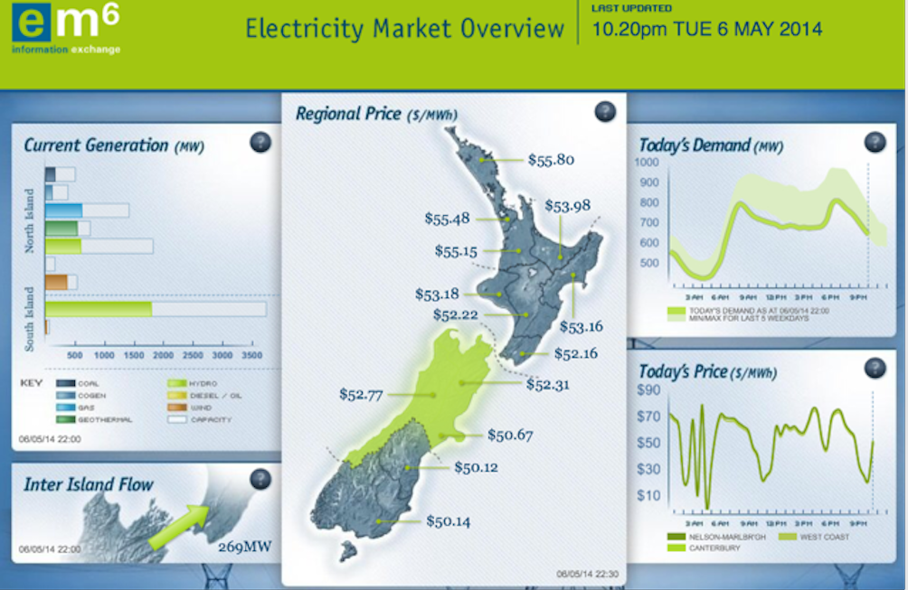
No relationship between price and demand

Slide 16
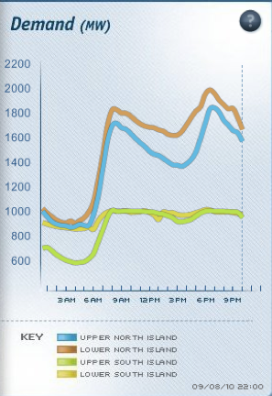
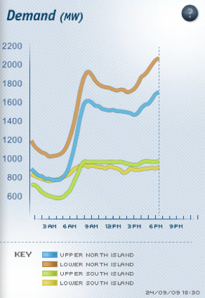
What ripple control can – and could – do.

Slide 17
What does the future hold?
Wind and solar power
$2 trillion has brought a very small return in CO2 reduction
in a world that has not warmed for 18 years.
Renewable energy subsidies have increased the cost of power to poor people
Unpredictable output brings the risk of serious power shortages
A rational society would abandon it
Fossil fuels
can provide a low cost reliable supply for the foreseeable future
Nuclear energy
Most people believe it is dangerous
in fact it is very safe
low levels of radiation are NOT dangerous
Can provide all the energy we need reliably and at low cost
needs a major change in attitude by the industry and regulators

Slide 18
What does the future hold?
DC transmission
will advance steadily and, maybe, supersede EHV AC
Distribution systems
will continue without much change unless
subsidies continue for uneconomic domestic solar power
electric car subsidies continue and batteries improve substantially
Smart metering
will continue in spite of of dubious economics
will fail to make a substantial contribution to demand side management

Slide 19
My predictions
In 25 years time:
dangerous man-made global warming will be forgotten
the world will be using even more fossil fuels
mining for clathrates will be well underway
nuclear power will be expanding
dismantling wind and solar installations will be an expensive problem
integrated high-voltage DC networks will be emerging
distribution systems will be much the same as they are now
electric cars will be less than 25% of the fleet
the more exotic aspects of smart grids will be forgotten
smart metering will continue to fail to deliver on expectations

