Slide 1
The smart grid and smart metering
will they really benefit the consumer?
Bryan Leyland MSc, FIPENZ, FIMechE, FIEE(rtd)
Consulting Engineer

Slide 2
What is a “Smart Grid”
According to the US Department of Energy
participation by customers
all generation and storage options
new-products etc
power quality
asset utilisation
meeting disturbances
resilient operation
Hasn’t it always done that?
Notes:
Heavily boosted by “stimulus money”
-Enabling informed participation by customers
-accommodating all generations and storage options
-enabling new products services and markets
-providing the power quality for the range of needs in the 21st century
-optimising asset utilisation and operating efficiently
-addressing disturbances through automated prevention, containment and restoration
-operating resiliently against all hazards

Slide 3
And what else?
“Accommodating renewable energy”
blind belief that it will mitigate global warming
BUT
very expensive
none of these technologies are economic
they need massive subsidies
no real benefit
Yet another hidden subsidy
for renewable energy?
Notes:
Little chance of being economic in the future
the big problem is long-term storage
the world have lots of energy
all we need to do is decide to make use of it

Slide 4
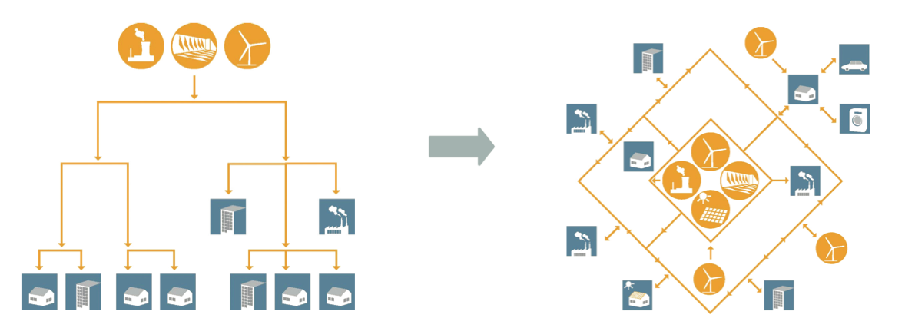
So what does it look like?
The present
The dream
Ripple control
What are the benefits?
Two way power flow huge data exchanges
Notes:
The dream needs multidirectional power flows and very complex communications
and there is one special factor for New Zealand –ripple control
We already communicate with –and manage–our loads
There must be very large benefits to pay for the complexity and the risk

Slide 5
Smart Metering
Why do it?
“To comply with EU directives”
Few cost benefit analyses
most showed a negative benefit
Ireland alone had objectives
peak demand
renewable and micro generation
enhance competition
improved consumer experience
energy efficiency
The cost will be billions of dollars
No convincing evidence of benefits
Notes:
I trawled the Internet to find out why
imply with EU directives was the most common reason
very few had carried out a cost benefit analysis and most were negative
Ireland
energy efficiency–why will it help?
Peak demand–we’ve got that covered
renewable and micro generation–heavily subsidised and a major burden on consumers already
enhance competition–by increasing the cost?
What on earth does that mean?

Slide 6
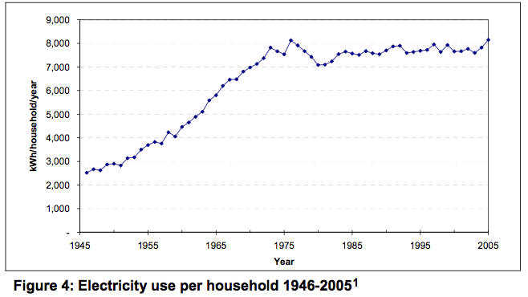
Energy Efficiency
8000
1945
1975
2005
How can smart metering improve on this?
Notes:
The obvious explanation for the stasis in electricity use is improved efficiency. So while every household has made more and more use of the benefits of electricity, technological progress has ensured that we don’t need any more of it. Most of this happened long before EECA was even dreamed of!
Exactly how can smart metering improve on this?

Slide 7
What is smart metering?
Remote meter reading
readings by month or by hour
and, maybe
making readings available on the web
displaying readings on a screen at home
controlling other appliances
managing (subsidised) microgeneration
controlling storage water heating
Notes:
More frequent readings are a good idea–but how much can we afford to spend on that?
-How many consumers are really interested in what they use every day or every hour?
- but how long before we have them?
-Microgeneration needs heavily subsidised feed in tariffs–we don’t need that!
-replacing a perfectly good ripple control system
So we are left with the one job that that is done very well now.

Slide 8
Managing the demand
Will consumers manage their demand?
What if they decide it is a waste of effort?
Must be predictable
obligatory and centrally controlled
Doesn’t ripple control do this?
Notes:
The dream is that consumers will be incentivised to manage their own demand on a day by day basis
But what happens if they decide it is a waste of time or do it only when they have got nothing better to do?
Demand-side management must be predictable to be useful to the system operator–Very important
So it has to be obligatory and managed centrally
So why do we need smart metering? ripple control can also manage appliances–it is doing so in Australia

Slide 9
Controlling appliances
How much do they use kWh $
Water heating 3kW 2400 480
Refrigeration 400W 1120 220
Lighting 915 180
Range 497 100
TV etc 364 62
Computers/games 227 41
Washing machines/Dryers 180 36
Hot water control is the major opportunity
Notes:
Water heating and, to a degree, refrigeration could be managed invisibly
none of the others can
anyway, they don’t use much power
the huge benefit comes from water heating because it alone makes a major difference to peak demand

Slide 10
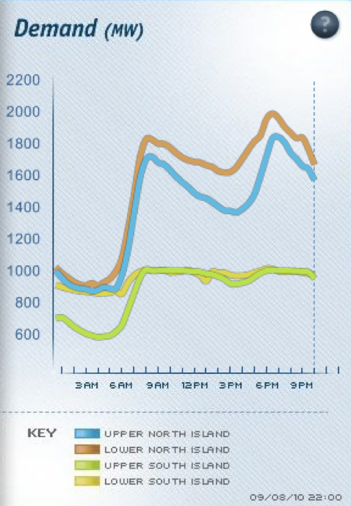
Demand control
North Island is not managing demand
South Island is showing what could be done
Demand could easily be reduced
Notes:
Load curves on a high demand day
the North Island is not controlling demand
South Island is controlling demand
why the difference?
There is no real incentive on the lines companies or the retailers to manage demand–Apart from loading on the lines company system
but the South Island lines companies are doing it anyway
40 years ago, everyone did it and New Zealand load was substantially constant for 12 hours on a peak demand day
if we did that now, it would save us two or 300 MW of generating capacity
with lots of wind power, it is even more important
windpower puts extra fluctuating demands on the remaining generation

Slide 11
Managing demand
Smart metering could do this
but only if
the loads were centrally controlled
Ripple control
major use–limit peak demand
it could and should
manage spikes in the spot price
help cope with windpower
help during transmission constraints
provide 200 MW of frequency response

Slide 12
Compulsory water heater control?
Consumers have no choice on under frequency load shedding
goes off, they lose all power
water heating goes off, they don’t notice
Consumers are obliged to buy large insulated water heaters
only of value if heating is controlled
If it’s universal the national benefit is very large

Slide 13
Discretionary expenditure
The dream
consumers will monitor and manage their demand
The risk
savings will be small, the inconvenience great
they will give up
Bigger savings to be made on telephone calls and walking instead of driving to the nearest dairy

Slide 14
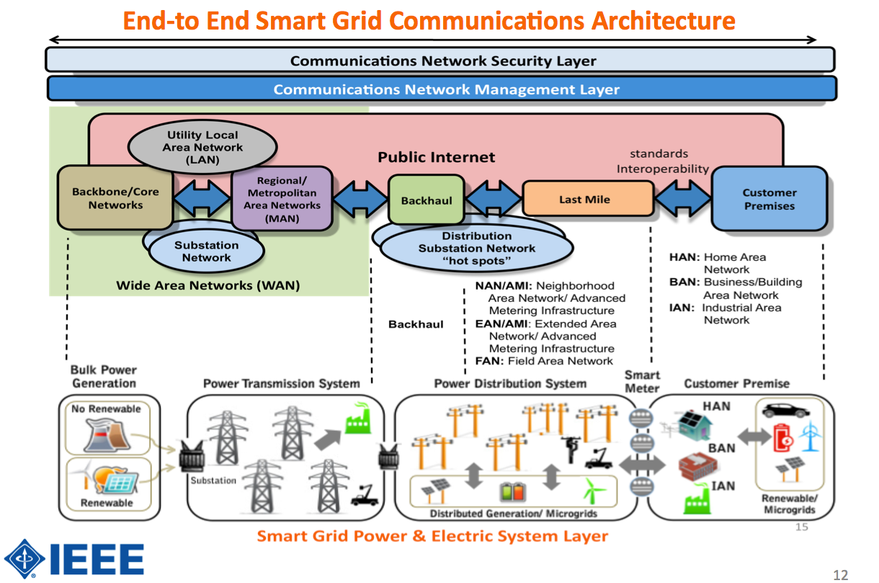
Security
Hugely Expensive, Diabolically Complex, Massive Security Risks
Where is the overall benefit?
Notes:
A network of mind-boggling complexity and cost
massive amounts of data to be handled–and lost, and misread, and misallocated
'Without better security, this increased control can fall into the hands of criminals, giving them the ability to modify billing information and perhaps even control which customers or appliances get electricity,' Woolsey says. '90 to 95 per cent of the people working on the smart grid are not concerned about security and only see it as a last box they have to check.'
And exactly what is the benefit that offsets all this?

Slide 15
Remote meter reading
“Drive-by” metering is an alternative
can also read gas and water meters
means that the house is checked every time the meter is read
a fraction of the cost of normal meter reading
which is fairly cheap anyway
Reading by text message is another
If it saves the retailer money, it’s good
If it costs the consumer, it’s bad

Slide 16
The really smart meter
Multi-rate meter with ripple control
Text message or drive by reading
Switchable rates
Optional remote display to advise rate
indicate a major system problem?
Control water heating, heat pumps etc
Low cost, effective and secure

Slide 17
Conclusions
Smart Grid is what we have always been doing
Better and cheaper ways of modernising meter reading
Huge security risk
Relies on consumer action
Water heater control is the major attraction
Why aren’t we exploiting ripple control!

