Slide 1
To register your vote and questions go to:
“Renewable energy technologies can provide a reliable, low cost electricity supply for NZ without burning fossil fuels”
Moderator: John Blundell
Speakers (in order)
Bryan Leyland
John Irving
John Boys
Robert Tromop

Slide 2
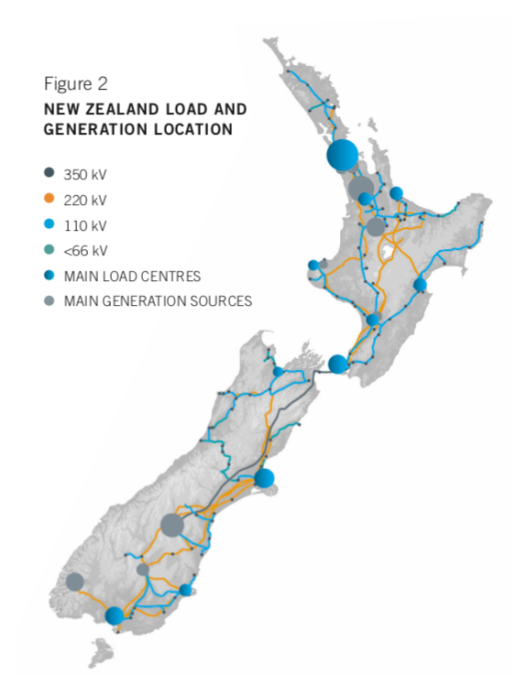
The NZ
system

Slide 3
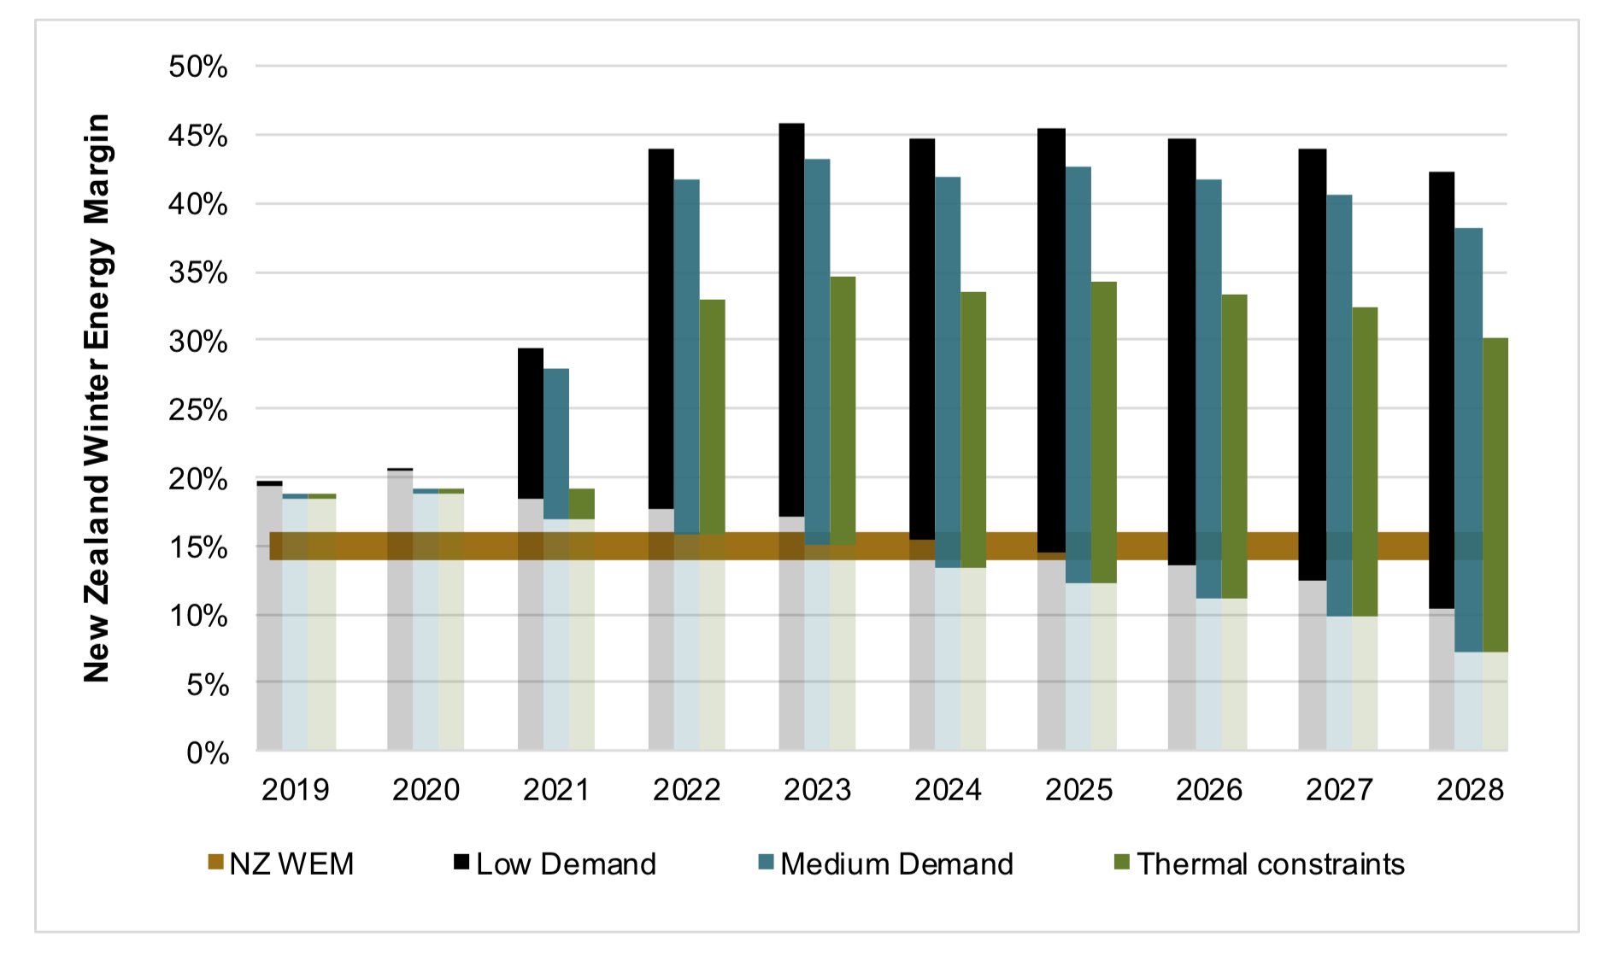
New generation is needed
Dry year risk
2022

Slide 4
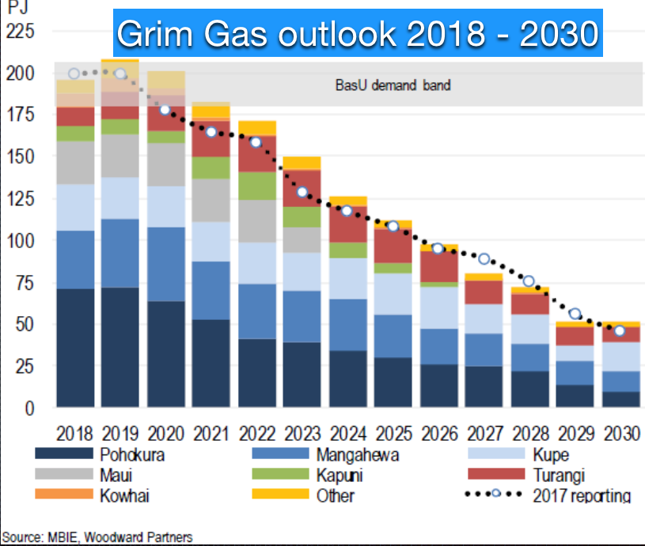
New Zealand’s Low Cost Options
Hydropower
Geothermal
Gas
Coal

Slide 5
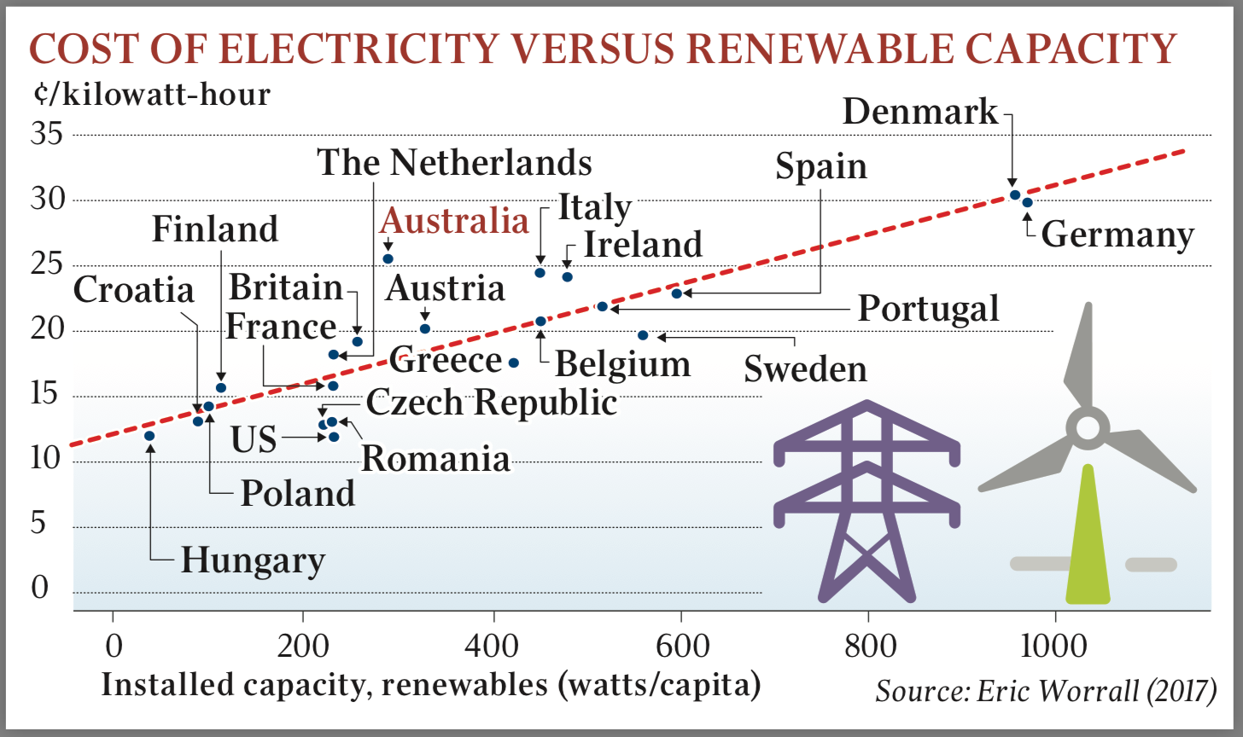

Slide 6
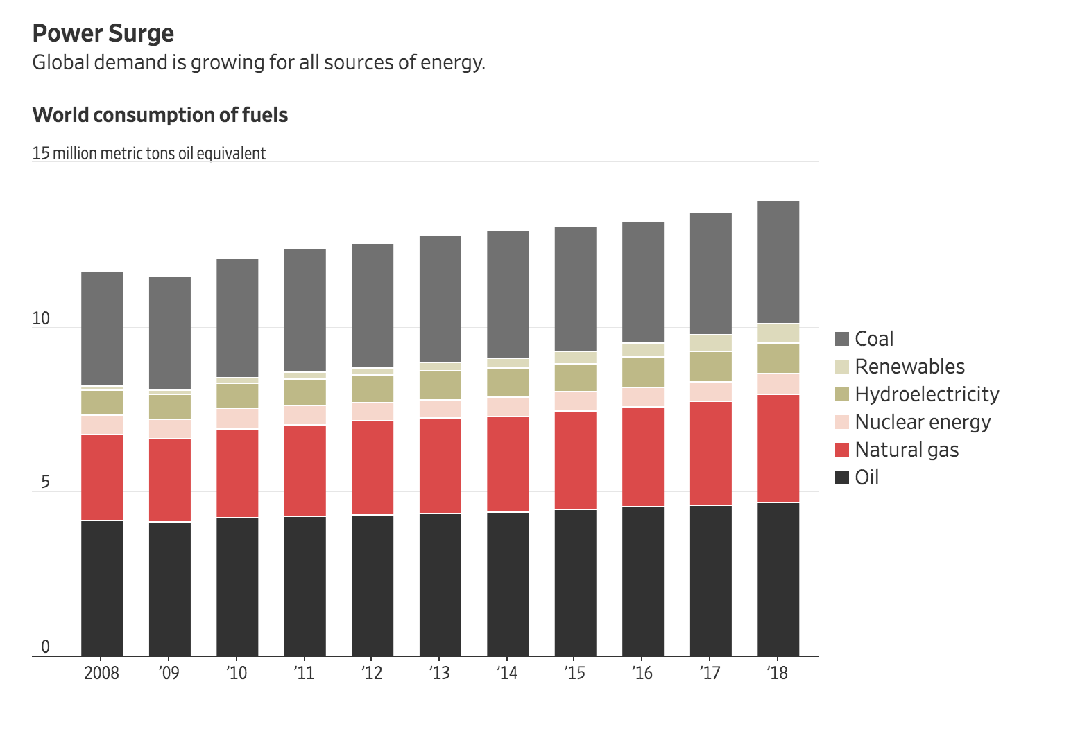
World Energy 09 - 18
Coal
Renewables
Hydro
Nuclear
Gas
Oil

Slide 7
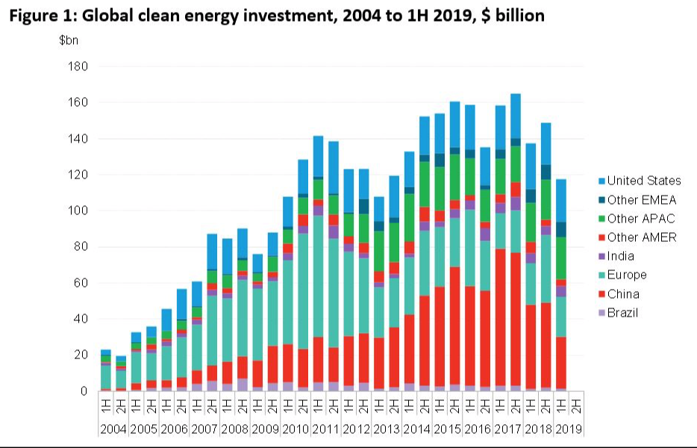
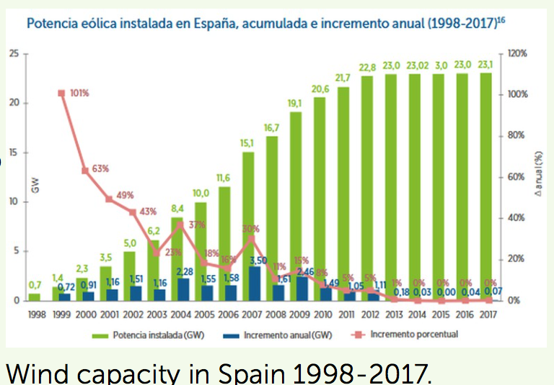
USA
Europe
China

Slide 8
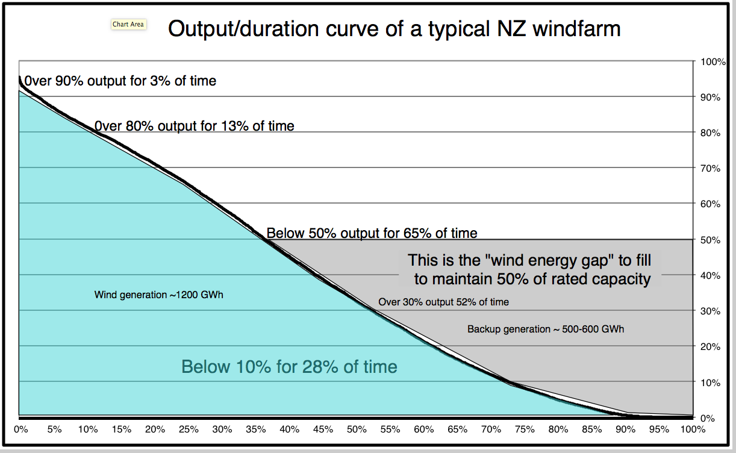

Slide 9
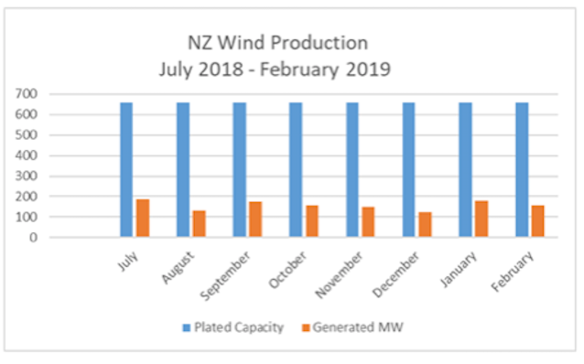
Recent NZ wind
700
200
Capacity
MW
CF Normally 37%: why did it drop to 24%??

Slide 10
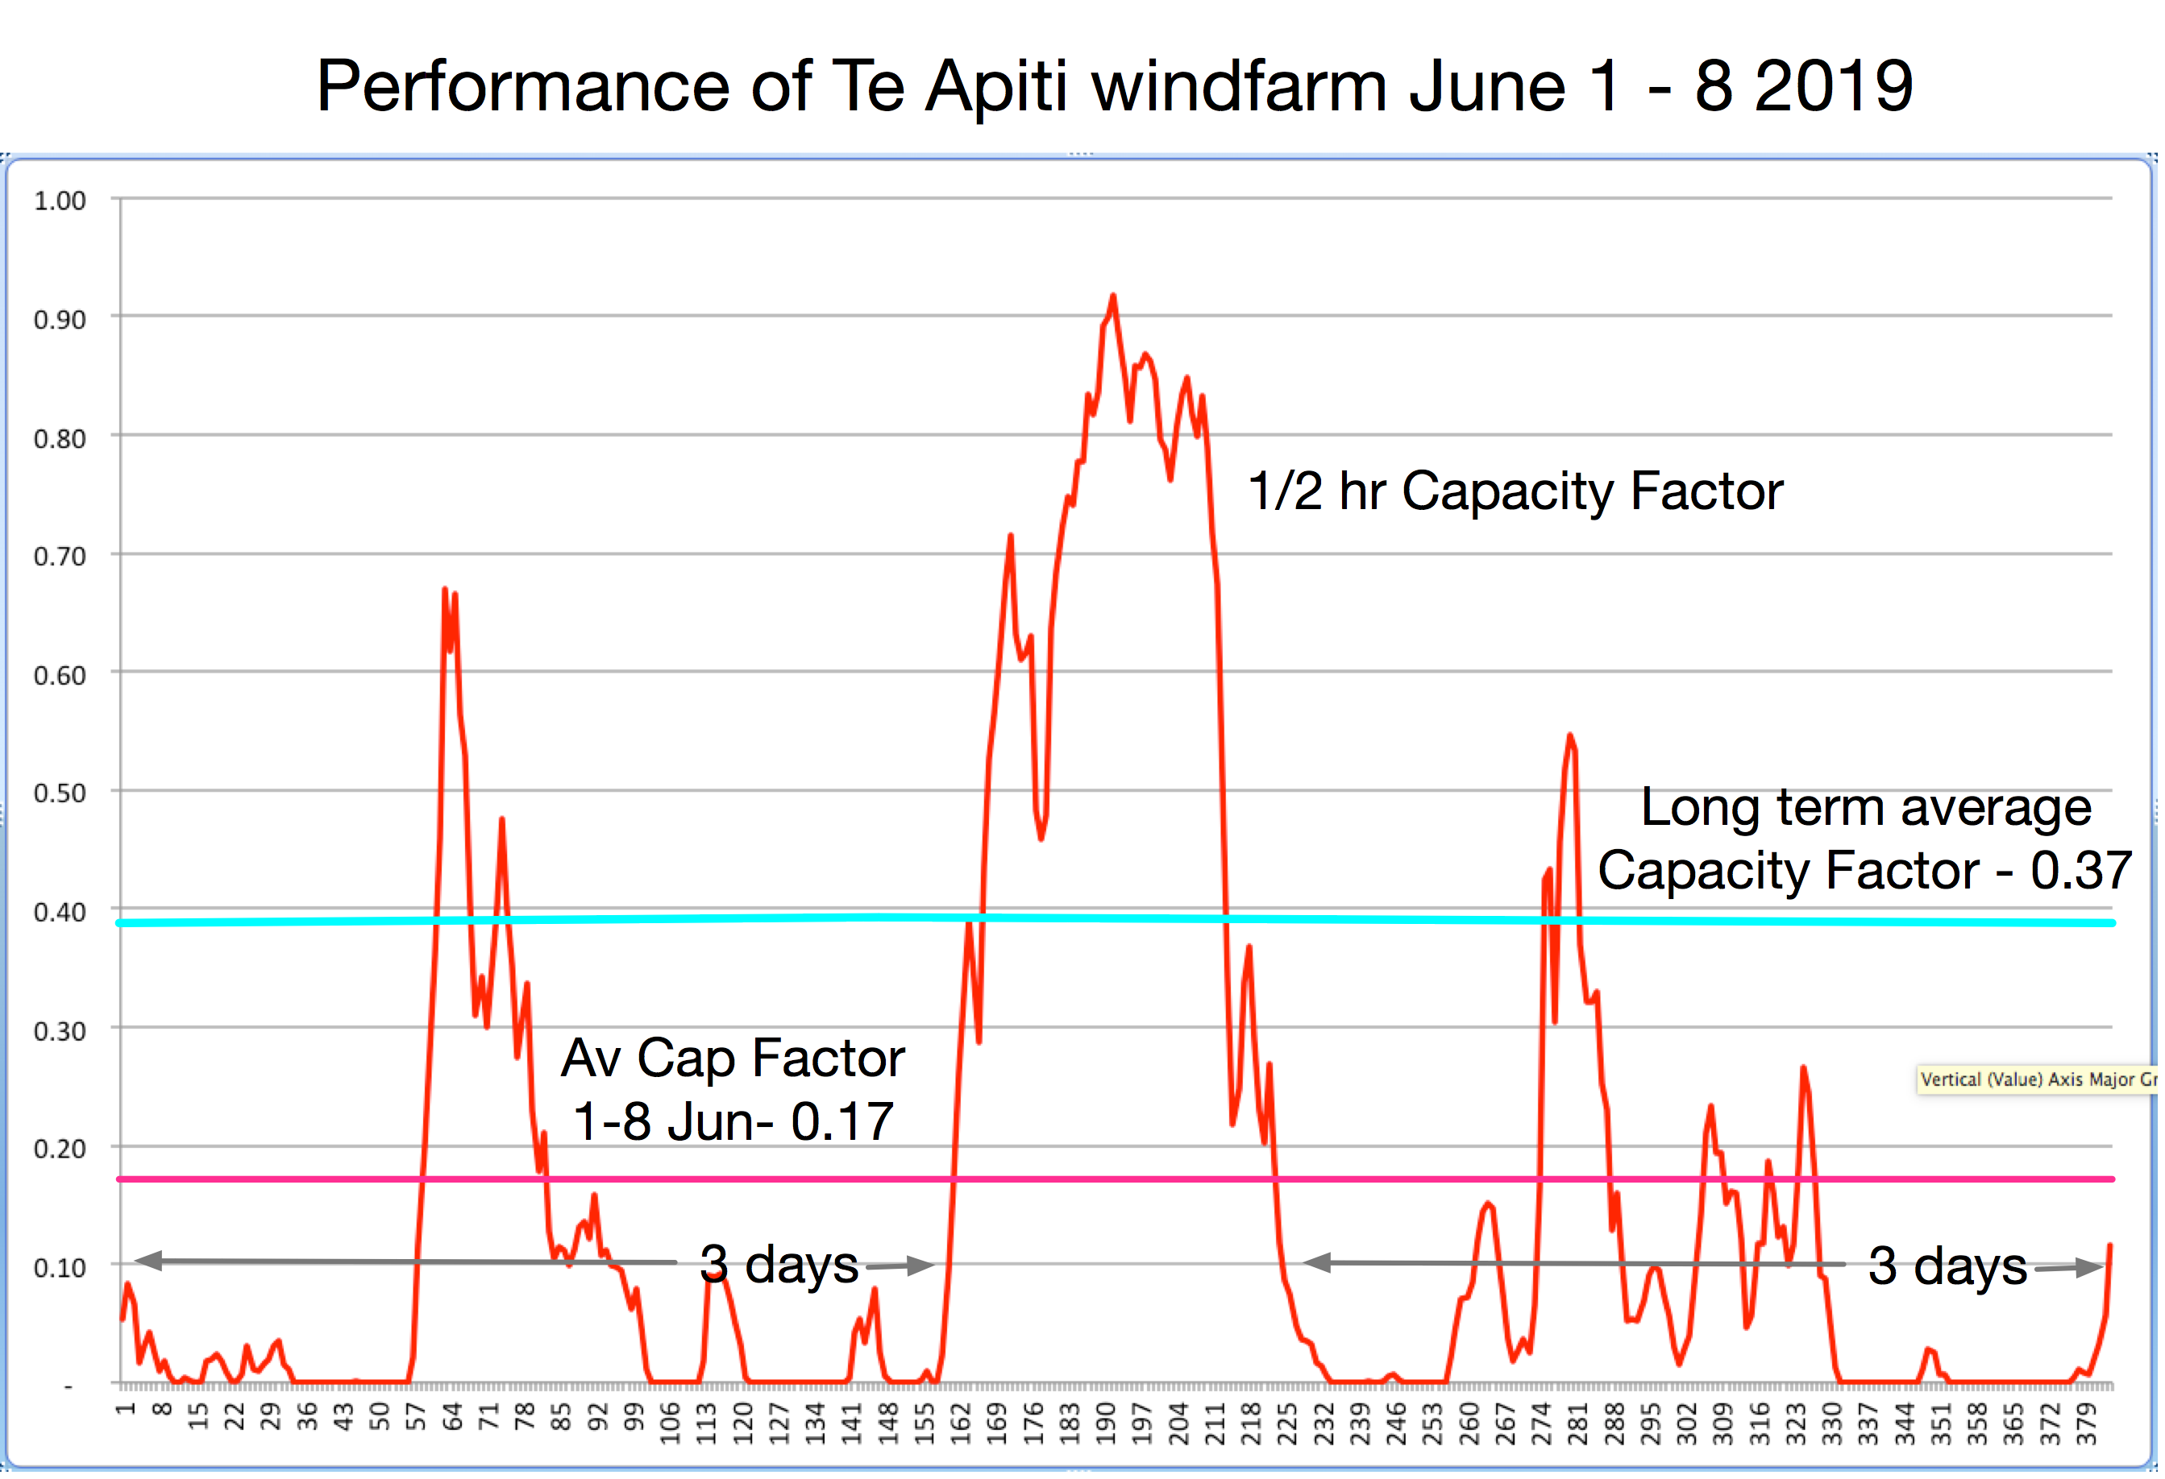

Slide 11
ICCC Report
Prioritises the accelerated electrification of transport and process heat over pursuing 100% renewable electricity …greater emissions savings while keeping electricity prices affordable

Slide 12
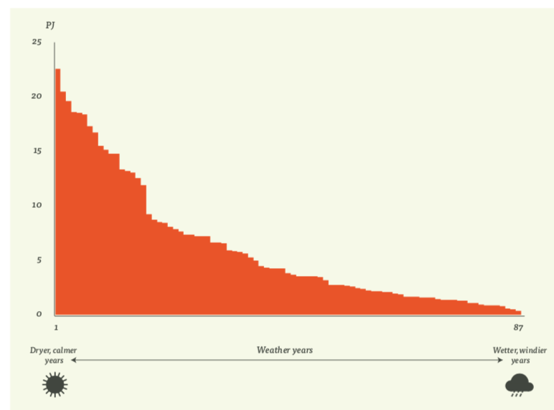
7000 GWh = 16% of annual energy
= 2500 MW of gas turbines!
Gas
is
essential!
Gas use from dry to wet years
for 99% renewable
Dry
Wet

Slide 13
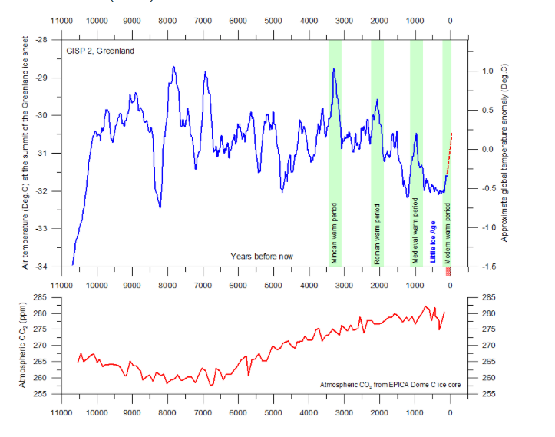

Slide 14
There
Renewable energy technologies
CANNOT provide
a reliable and economic supply
The cost per kW in $NZ, using US costs, for building each type of power plant:
• PV Solar: $1,300
• Wind: $2,600
• Coal: $4,000
• Natural Gas: $1,500
Cost in cents per kWh:
• PV Solar: 20
• Wind: 7.2
• Coal: 6.0
• Natural Gas: 2.5
Wind and PV Solar are more expensive and need backup

Slide 15
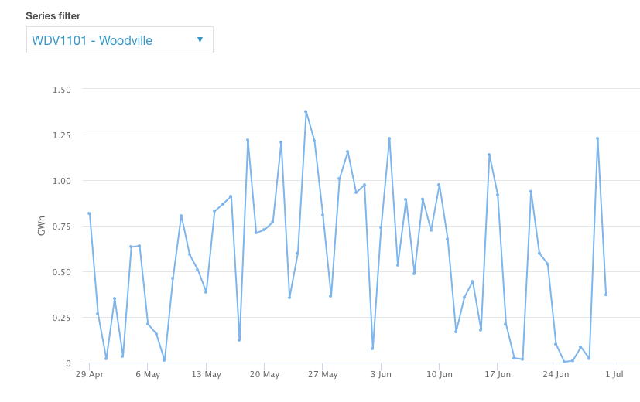
Te Apiti ~ 0 kW on 4 peak days
Max output
Max output

Slide 16
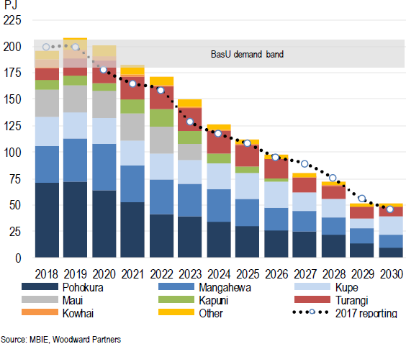
Grim Gas outlook 2018 - 2030
Grim Gas outlook 2018 - 2030

Slide 17
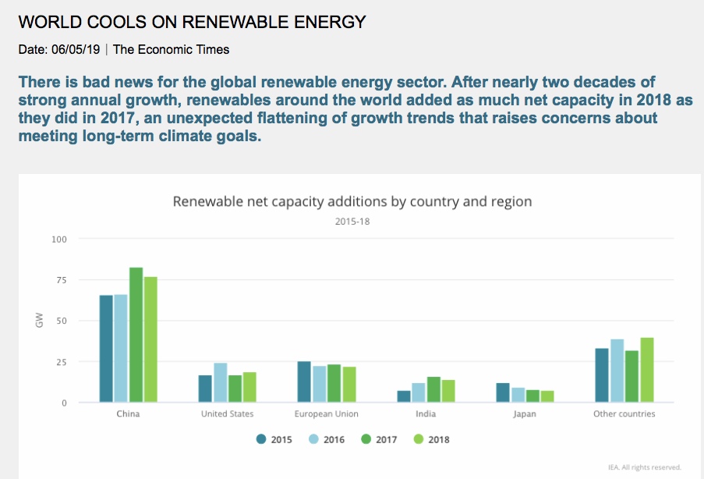
Renewables added 2015-2018
World installed capacity 6500 GW
100 GW
China
USA
EU
India
Japan
Other
https://www.thegwpf.com/green-stagnation-the-world-cools-on-renewable-energy/

Slide 18
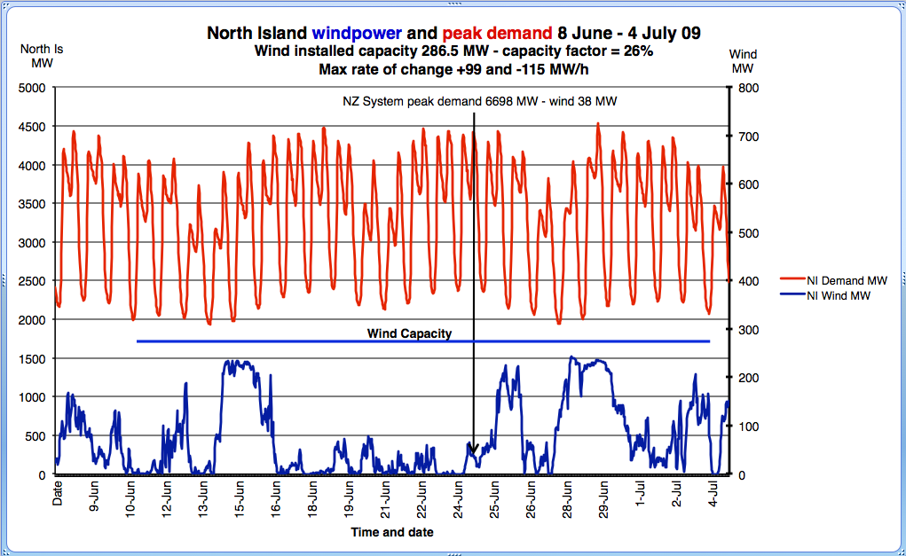

Slide 19
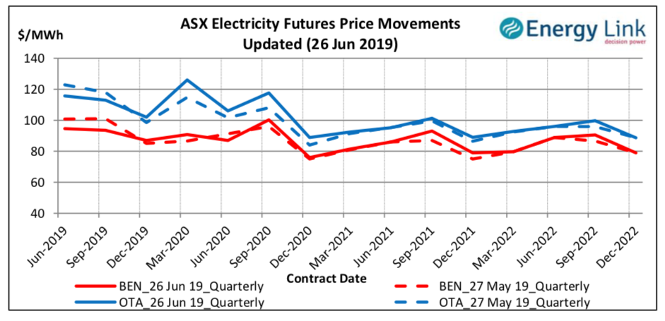

Slide 20
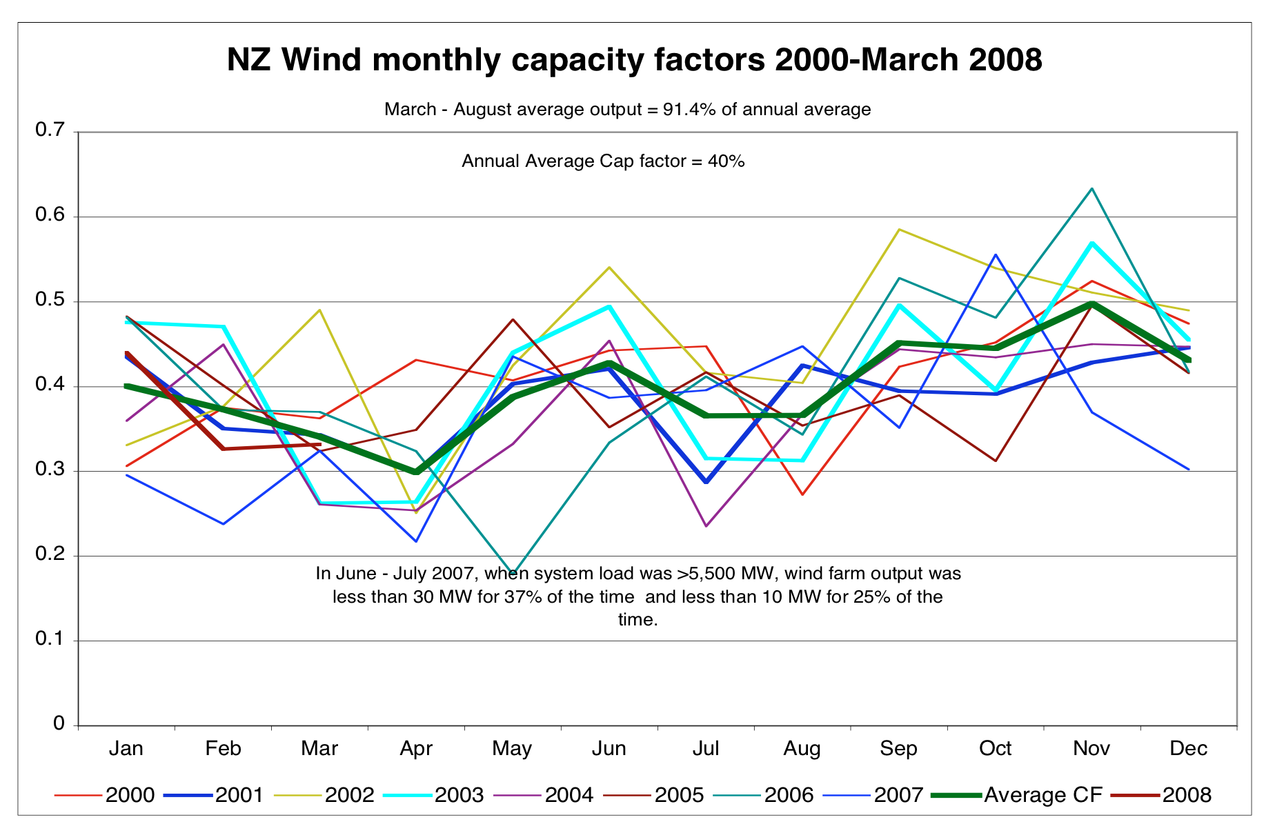
Wind is least when we need it most

Slide 21
