Slide 1
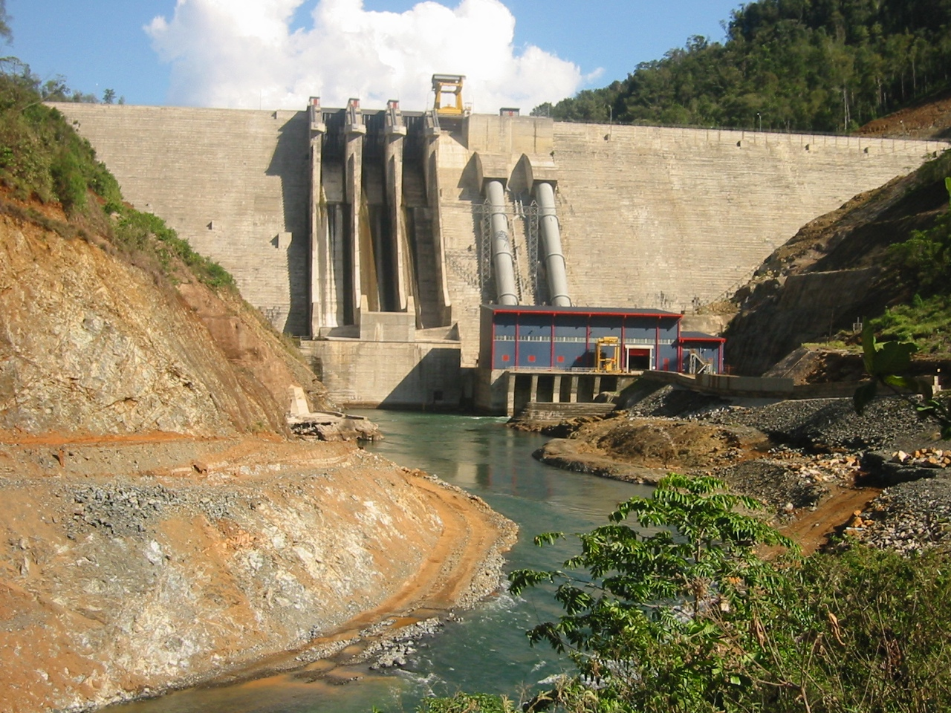
Gated spillways - are they safe enough?
.,,
Bryan Leyland
MSc, FIEE, FIMechE, FIPENZ
Leyland Consultants
New Zealand
1

Slide 2
Safety considerations
Failures of large dams have drowned thousands of people
The hydro industry has no universally accepted and monitored safety standards
Accidents and near accidents are not reported and analysed
Gate safety is seldom analysed
many designers believe that the operators are primarily responsible for safe operation

Slide 3
Spillway Safety
About 30% of dam failures are caused by gate failure
at least 7 dams have failed..
Many gate systems can be totally disabled by
power supply failure
control system failure
operator error
Many gate systems have a 1:100 probability of failure
It should be >1:10,000

Slide 4
Spillway options
Overspill - no risk of failure
Float operated gates - very low risk
Flap gates - low risk - open without power
Radial gates - high risk - power needed for opening
range of lifting systems - some better than others

Slide 5
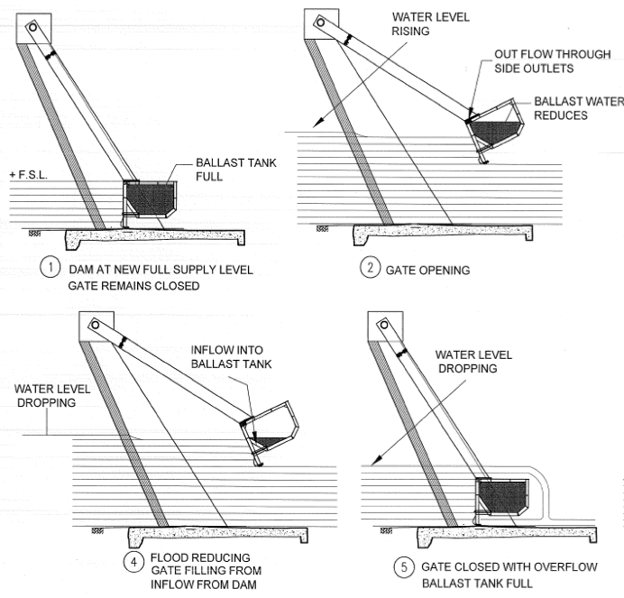
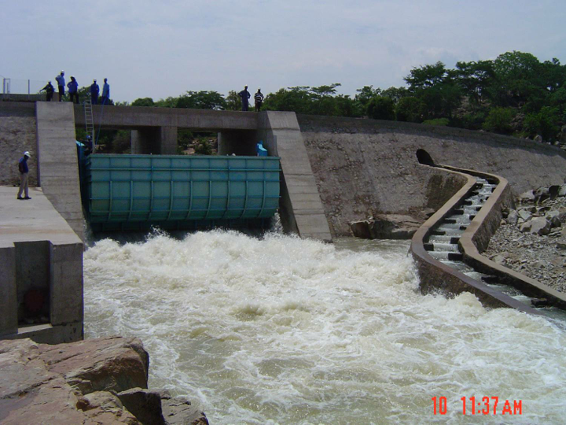
TOPS gate
www.amanziflow.co.za

Slide 6
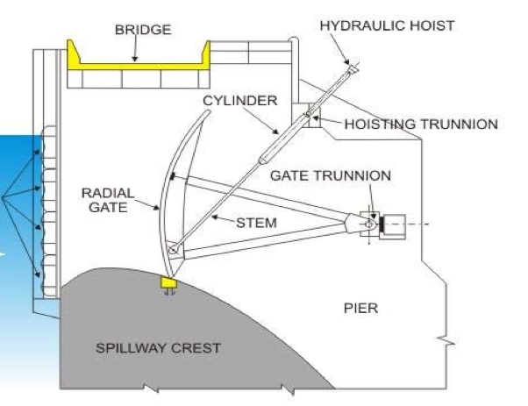
Radial gate
An external power supply is needed to open the gate
The cylinder is long and expensive
If it seizes up the gate cannot be opened
If a hose fails the gate cannot be opened

Slide 7
Gates that need power to open
A single event should not result in failure
Redundant reliable power supply
Diesels..
battery must be ok
tank full of clean fuel
cooling system serviceable
Redundant control system
Open automatically if operators are absent

Slide 8
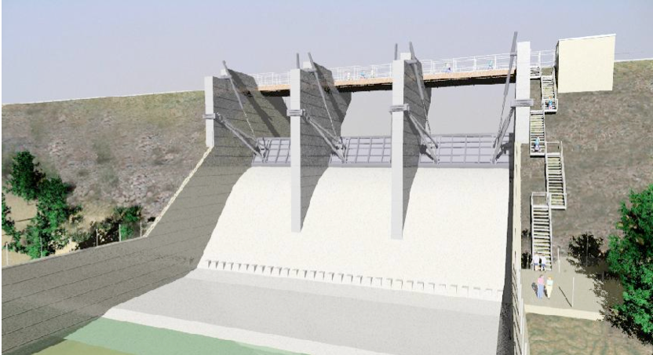
Ross River Dam - Australia

Slide 9
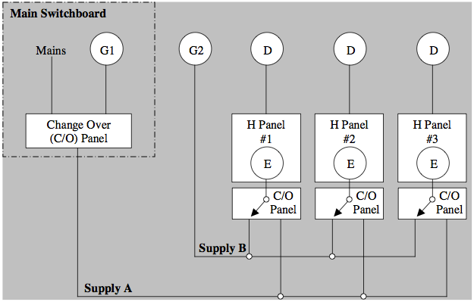
5 diesels for 3 gates!

Slide 10
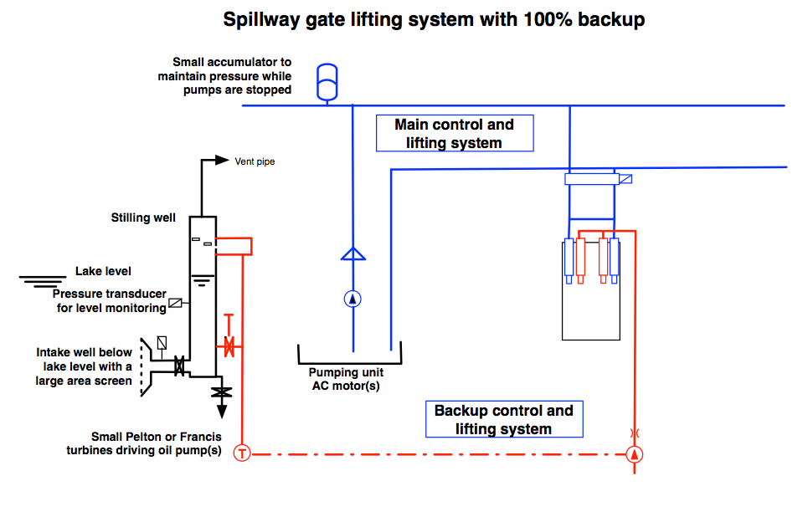
Main and backup lifting gear
One set is conventional
The backup set does not need an outside power supply or operator intervention

Slide 11
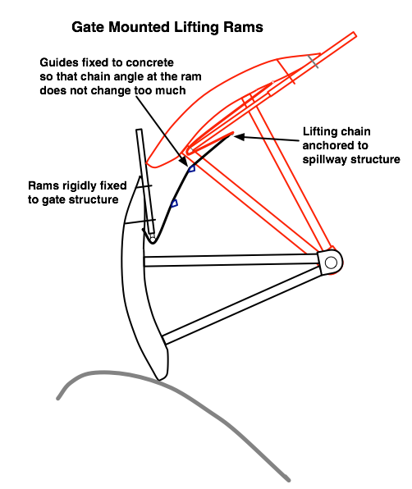
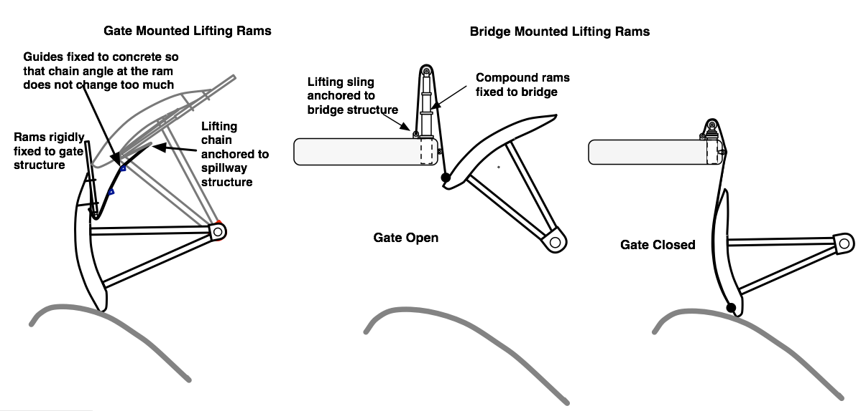
Alternative lifting gear

Slide 12
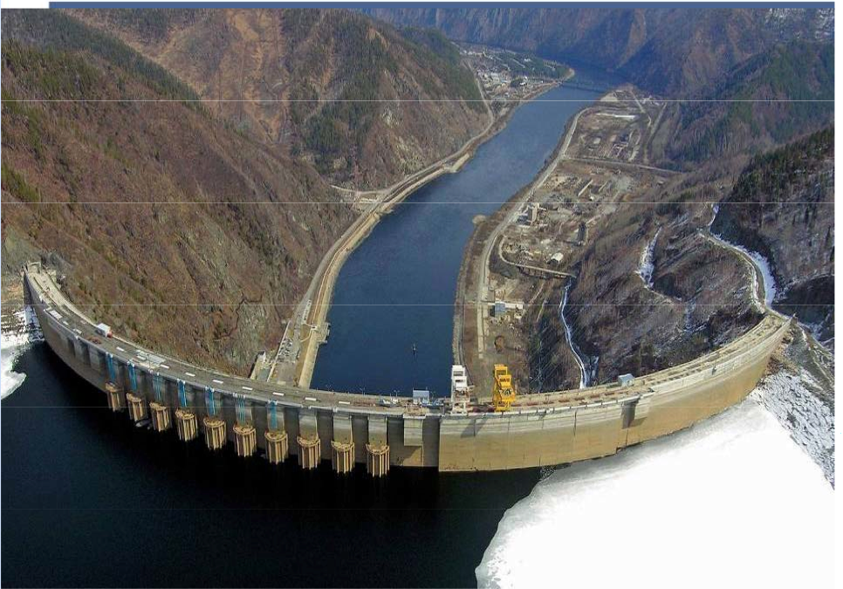
Sayano Shusenskaya accident
6400 MW
Concrete arch-gravity dam 242 m high
Crest length 1074 m
Power station was flooded

Slide 13
6400 MW station
Supply to the single gantry crane was lost
Emergency arrangements were made in time
The accident happened at 8:13:25 local time
75 lives were lost
Single gantry crane lifts
all 11 spillway gates

Slide 14
If the Dam had Failed..
The 300 MW Maynskaya Hydro would have been destroyed in a matter of minutes
An hour or so later the town ofSayanogorsk would be flooded - more than 200,000 people at risk.
The 6000 MW Krasnoyarsk dam would have been overtopped
If it failed, Krasnnoyarsk city would have been flooded

Slide 15
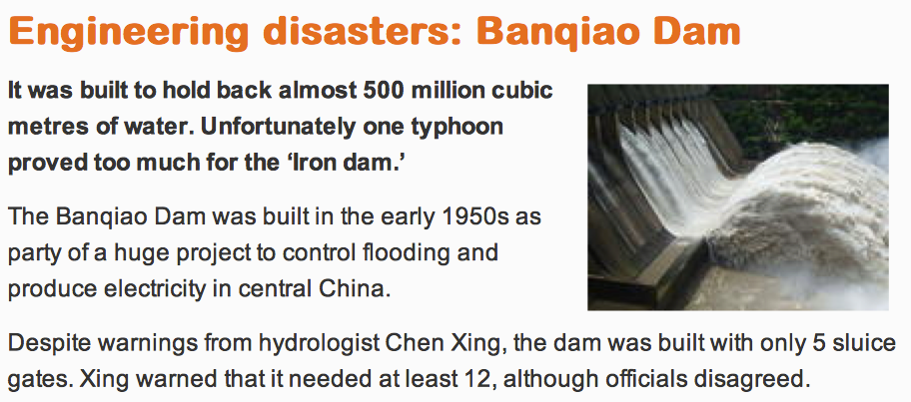
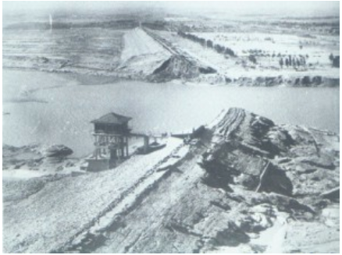
Banqiao Dam Failure - China
It should have had more spillway gates
Banqiao dam in China failed in 1975
and killed >175,000 people

Slide 16
Machhu 2 failure 1979 - India
2000-10,000 died

Slide 17
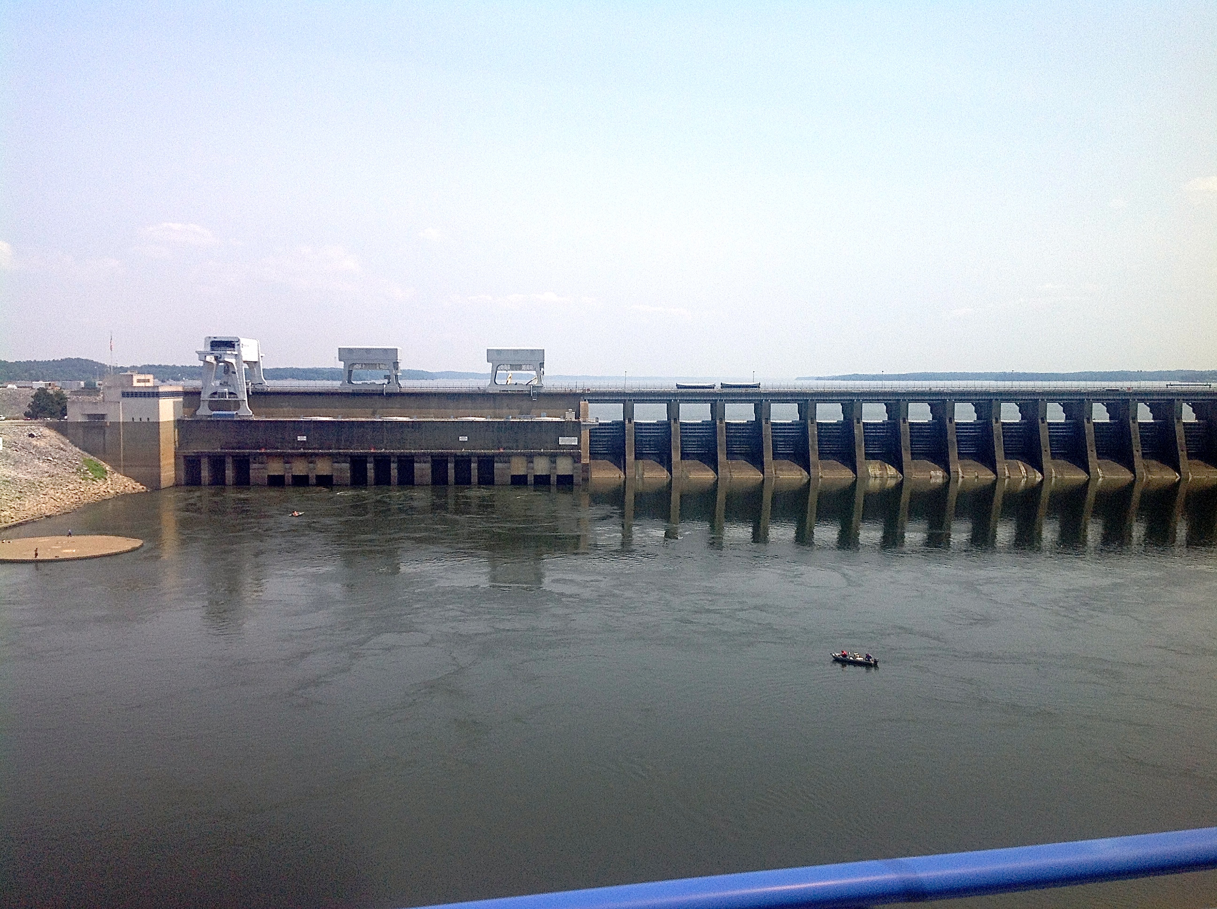
Kentucky Dam USA
Two gantry cranes to lift 24 gates!

Slide 18
Recent experience
I was a member of a Dam Safety Panel for a dam in Africa
responsible for gate safety
The design included 14 - 6m x 6m radial gates
the previous consultant had recommended 6 m high flap gates
I said that the radial gates were too risky
recommended flap gates - cheaper, safer and more flood capacity
The Panel President insisted that the radial gates were safe
I resigned

Slide 19
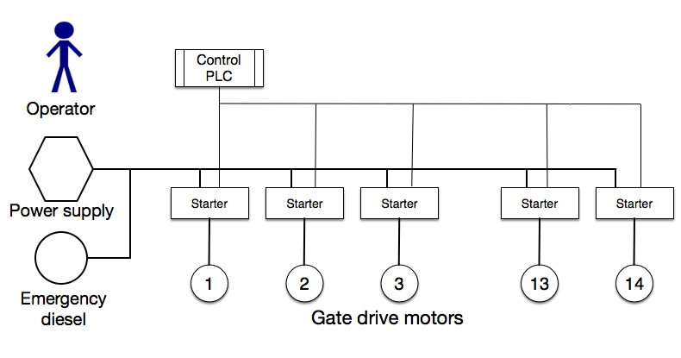
Failure modes
X
X
X
X
X

Slide 20
What can be done?
Modern health and safety legislation requires
avoid risks or manage those that cannot be avoided
adapt working conditions, equipment and methods taking into account development in techniques

Slide 21
What are the implications?
An engineer must
examine the safety implications of his design
assess the risks of his design and alternatives
choose the design that offers the least risk at a reasonable price
record the results of his evaluation and, if a major safety issue is involved, get it peer reviewed
If this is not done and an accident occurs, the engineer could face very serious charges including manslaughter

Slide 22
What else could be done?
Set up an international organisation that obliges all designers and operators of large dams to:
adhere to an agreed set of safety standards
review designs in accordance with the standards
report all failures and near failures so that, if necessary, the safety standards can be amended
If this is done, dam safety will approach the safety standards of aeroplanes and nuclear stations that are already much safer than hydro dams
If it is not done, the risk of another major dam failure killing thousands of people will remain

Slide 23
Summing up
Large dams
store huge amounts of energy
cannot be abandoned
decommissioning is virtually impossible
will be a risk to future generations for the forseeable future
Gates are a major risk factor

