Slide 1
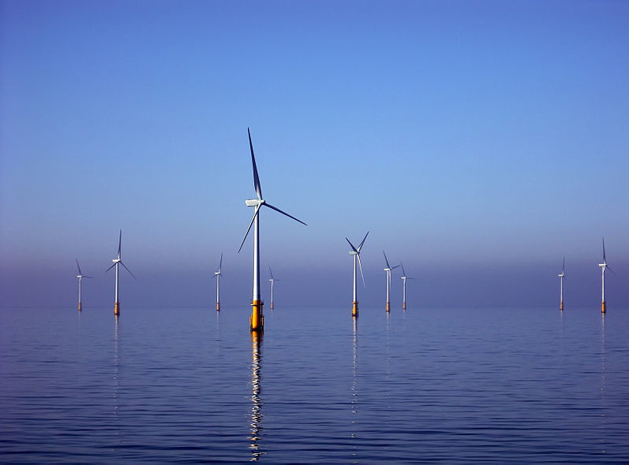
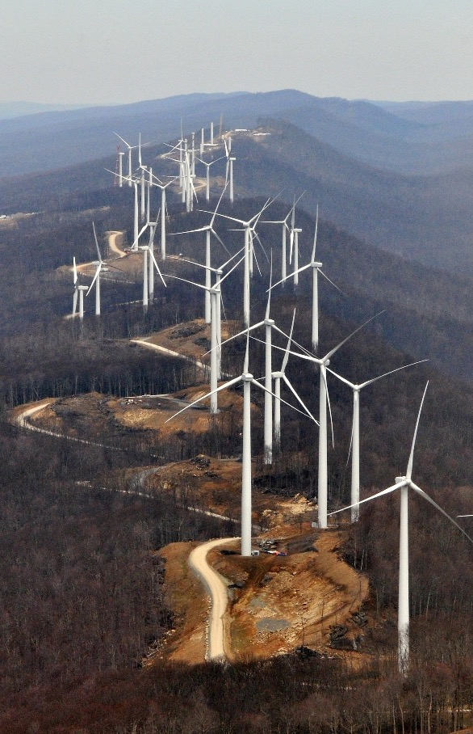
Carbon Zero
Bryan Leyland
MSc, DistFEngNZ, FIMechE, FIEE (rtd)
The dream The reality
Notes:
Nothing we can do wil change the climate of New Zealand It is all about virtue signalling
ICCC report is excellent
CC report is 400 pages and doesn’t say much
Not mentioned: System stability, inertia, MW, GW, GWh, Max demand,
It does say that the NZ battery project could cost billions of dollars.

Slide 2
The Commission’s Advice
The Commission advises that we must achieve net zero by 2050 by:
Electrifying transport
Electrifying heating
Massive increases in wind and solar power
This implies
Increasing generating capacity by about 160%
Commissioning ~5000 MW of short and long term energy storage
Can do we do it?
The engineering and economic challenges are enormous
Notes:
Some things would increase worldwide emissions!

Slide 3
Electrify transport and heating
The Commission wants us to start now. Why?
For as long as Huntly is generating….
Replacing a coal fired boiler with an electric boiler results in Huntly burning two and a half tonnes of for every tonne “saved”
Electric cars will be fuelled by coal fired electricity
Renewable power system first
THEN convert transport and heating to electric!
Notes:
The Commission wants us to start now, ~10 years before gas and coal have been effectively eliminated from power generation

Slide 4
The grand plan
 | 2020 -2025 | 2025- 2030 | 2030 - 2035 | 2050
Vehicles | Electrify transport | Electrify transport | No more ICE vehicles | All electric?
Planes and ships |  | Electrify ships | Electrify planes | ???
Heating | Kill new gas heating | Kill new gas heating | Kill existing gas heating | All electric
Electricity | Phase out coal and gas | Upgrade grid | ~ 95% fossil free | Still burning some gas
Notes:
To keep its current range, the A380 would need batteries weighing 30 times more than its current fuel load, - it would never get off the ground.

Slide 5
Transport cost -14,000 km pa
Electric car costing $60,000 + $3000 for home charger
Home charging 2500 kWh @ 35 cents $875
Road user charges @ 8.1 c/km $1134
Total $2009 14 c/km
Commercial charging @ 25c/min + 25 c/kWh
22 kW charger = 93 c/kWh 24 c/km
Diesel car costing $40,000
6 l/100 km = 840 l fuel at $1.3/l $1100
Road user charges @ 8.1 c/km $1134
Total $2234 16 c/km
Is electric worth the extra cost and the refuelling problems?
Notes:
A charging station with 50 X 50 kW chargers would cost ~$10 million.
500 would cost 5 billion!
An equivalent petrol station would cost ~$2m

Slide 6
Transport energy
50 billion km travelled by light vehicles pa
= 8 GWh
Average charging power ~ 1000 MW
Off peak charging load 3000 MW?
House with electric car
7.4/22 kW charger 1 phase/3 phase
14,000 km pa ~ 2500 kWh pa - 30% increase
Probably adds 2000 MW to NZ peak demand
>20-25% extra Distribution costs ~ 2.5 ¢/kWh ~ $10 Billion?

Slide 7
Electric Cars Worldwide
Cost of CO2 reduction is $300 – $1000/tonne
Current CO2 (carbon) price is about $50/tonne in NZ
Electric cars are heavily subsidised yet they are only 2% of all cars worldwide
Batteries need lithium and cobalt – both are scarce and increasingly expensive
Unsustainable??
Are not a “must have” item like a Model T Ford or iPhone
Electric car = expensive conventional car with a small fuel tank that takes 30+ minutes to fill
Will enough people want to buy one?
Notes:
Kelly claims: “If we replace all of the UK vehicle fleet with EVs, using next-generation batteries, we would need:
twice the annual global production of cobalt ;
three-quarters of the world’s production of lithium carbonate
nearly the entire world production of neodymium; and
more than half the world’s production in 2018 of copper .

Slide 8
Electric heating
According to Prof Kelly converting heating to electricity would increase electricity demand by 7 GWh
Abandon
Coal and gas fired boilers
Gas water heaters
Gas home heating
Gas distribution system
The cost will be huge
Who pays??
Notes:
What are the benefits?

Slide 9
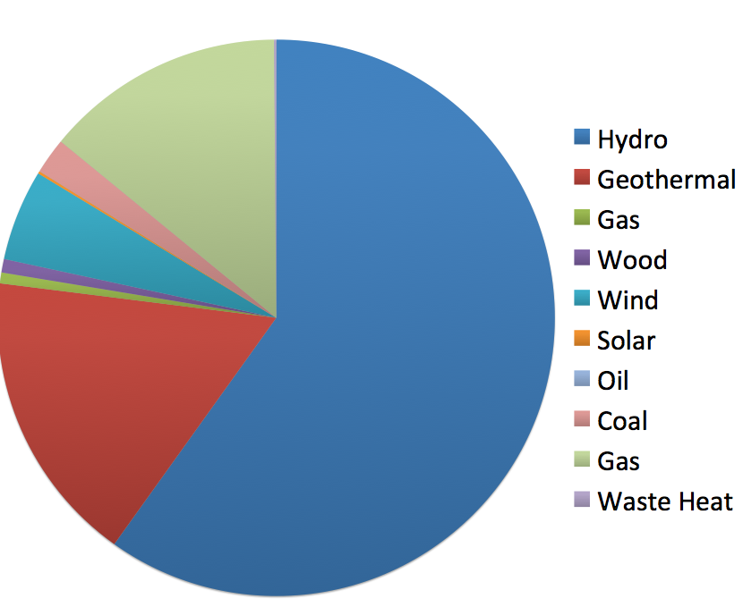
Where our power comes from
978 MW of geothermal 18%
690 MW of wind 5%
In 2020
Coal 4% Gas 12%

Slide 10
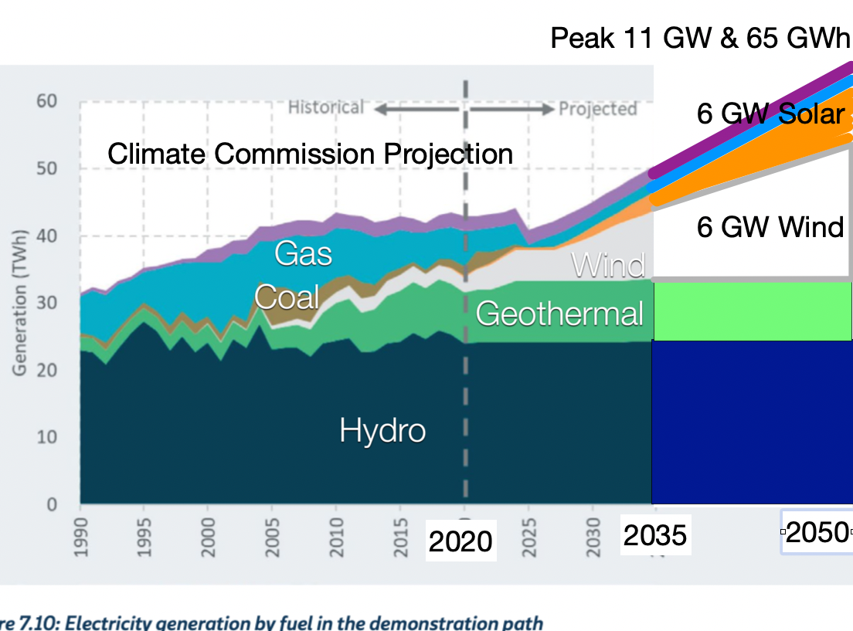
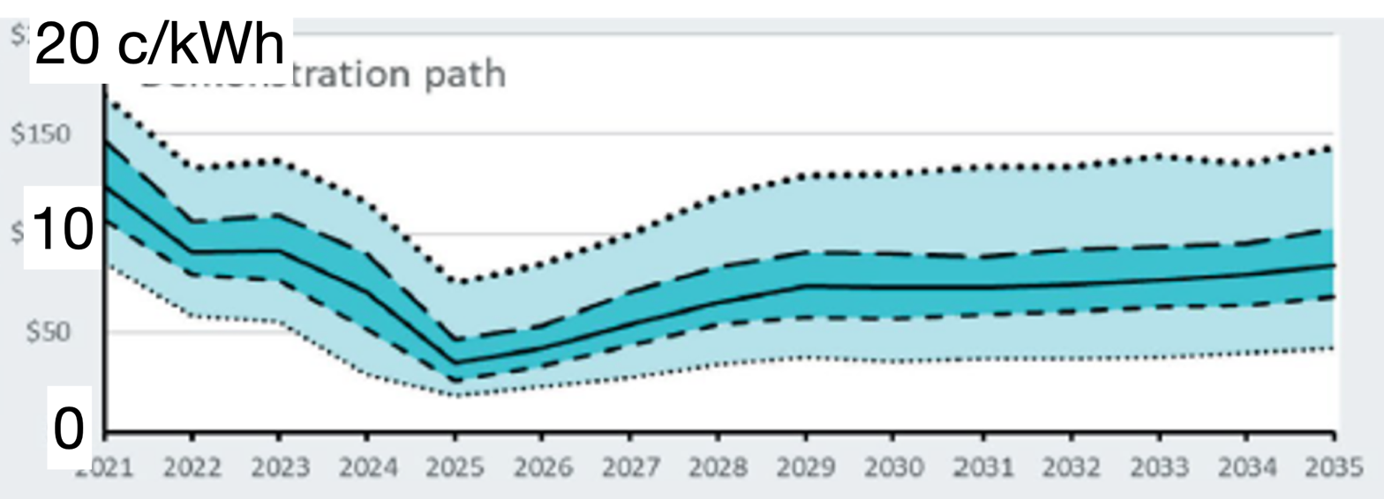
By 2050
Installed capacity
increases by 160%
from 9.5 to 24 GW
Demand increases
from 7 to 11 GW
Coal gone by 2025
Where will the gas
come from?
Wind - from 700 MW
to 6 GW
Solar - 6 GW
Hydro - unchanged
Storage ~5 GW
(not mentioned)
14.5 GW new capacity at $2500/kW
= $36 billion
Provides 23 GWh for 4GW increase in demand
$9000/kW!
At 8% ~15 ¢/kWh capital charges
Capital charges + O&M would be more
than twice the price predicted
by the Commission!
Ten 400 MW nuclear reactors at $20 bn
would be better and cheaper!

Slide 11
Characteristics of renewable energy
In a 1:20 dry year hydro generation drops by 15% over a 4 month period
Wind power can drop to less than 15% for days on end
Solar power generates for about six hours per day and drops by 75% on cloudy days
Capacity factors for wind and solar power in New Zealand are 36% and 18%
We need stored energy to keep the lights on when the wind isn’t blowing and the sun isn’t shining
We need to store the equivalent of 10% of annual generation for a dry year
How about 1m tonnes of coal at Huntly @ $150 m?
Notes:
e.g. 1 million tons of coal at Huntly costing ~$150 million

Slide 12
Storage options
The 12 GW of wind and solar power postulated for 2050 would need at least 5 GW of storage
Batteries are impossibly expensive
Five days backup for a wind farm would cost about 3x the cost of the wind farm
Cost is about 50 ¢/kWh stored
Other options are
Pumped storage schemes
Upgrading the smelter with new technology so that it can reduce load to help with dry years and fluctuations in wind and solar power
But they won’t come near to the 5 GW needed

Slide 13
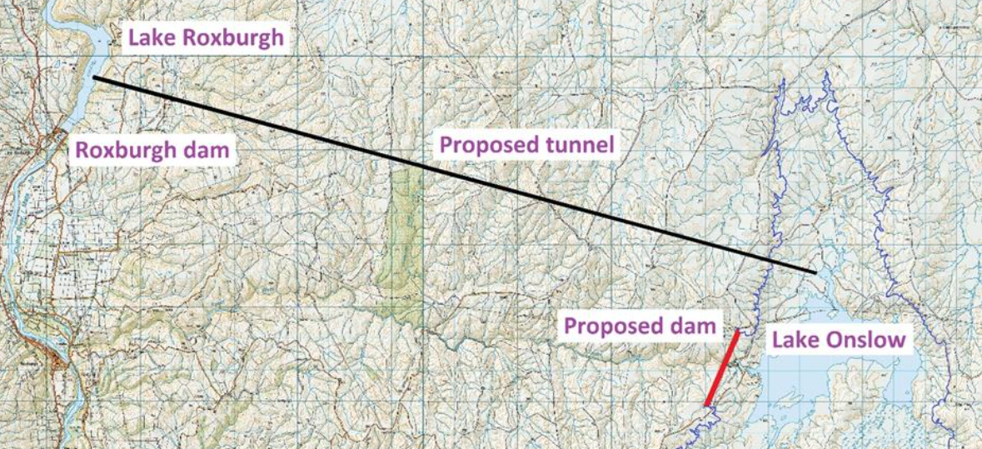
Lake Onslow
The government has great hopes for the Onslow pumped storage scheme near Roxburgh
It would take 15-20 years to complete and fill
Lake Roxburgh has limited storage
Will soon run dry when there is surplus wind and solar power available
Onslow is only 1200 MW
Hugely expensive/kWh stored
The only other option is large-scale demand management
i.e. rotating blackouts and wholesale installation of emergency diesels
23 km
Do storage and cost kill the CC’s dreams?

Slide 14
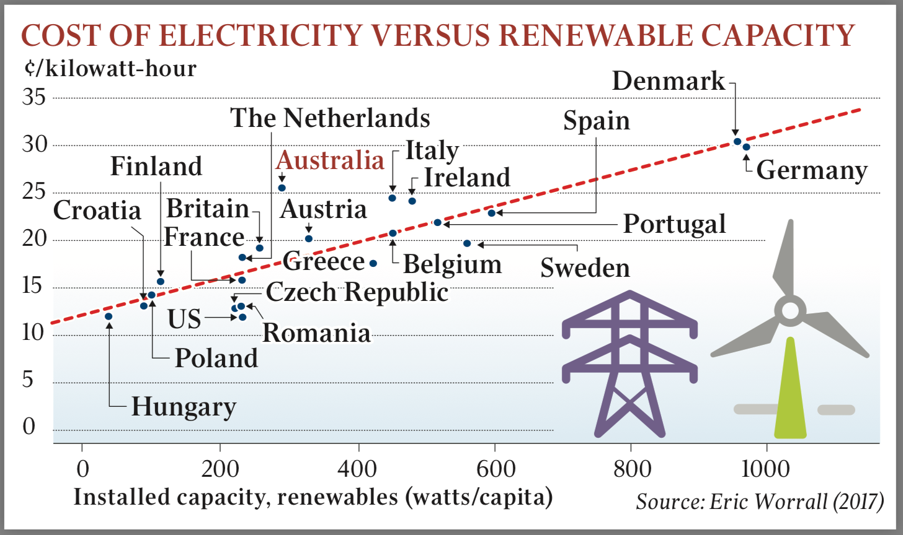
Wind and solar increase power costs
South of Scotland Electricity: “Most wind farms in Britain will not be economically viable when existing subsidies end and will close prematurely without further revenue support.”
Notes:
In the real world, renewables push up prices!

Slide 15
What is it all going to cost?
$ billion
Power generation 36
Transmission and distribution 20
Electric cars 3.5 million at $20,000 extra 70
Heating houses - 25% of 1 m homes on gas $5k each 12
Industrial heating – guess 10
Total cost at least… 150
Reduces emission by 30 M tonne pa? Cost/tonne pa $500
CC says that $250 per tonne is maximum price!

Slide 16
Outcome
The Climate Commission’s advice lacks engineering and economic input
If the government followed its advice
Electricity prices would increase rapidly
Frequent blackouts would be inevitable
The government would lose the next election
The government needs to consider other options

Slide 17
The government could consider…
Relying on the Emissions Trading Scheme to regulate greenhouse gases
The Climate Commission states that this is an option but takes it no further
Replace coal with more hydropower, geothermal and gas
Reduced emissions and cheaper power
Accelerate switch to modern efficient ICE vehicles and replace coal with gas
Actively consider safe, reliable and emissions free nuclear power
Recognise that nothing that New Zealand does can affect the world’s climate
Concentrate on reducing worldwide emissions
Initiate research into whether or not man-made greenhouse gases do cause dangerous global warming

Slide 18
ETS gives peverse results
Increasing carbon tax from $25 to $250 increases cost of generation at Huntly by about 25 ¢/kWh
The way the electricity market works this will deliver windfall profits of 25 ¢/kWh to other generators most of the time.
For every 25 ¢ paid in carbon tax by Huntly the consumers will pay ~$2.50 in windfall profits to the other generators
Which motivates the other generators to keep Huntly running on coal!

Slide 19
More hydropower, geothermal and gas
More than 1000 MW of hydropower available
Lower Waitaki, Clutha and West Coast
600 MW more geothermal
Huge gas potential including shale gas in the South Island

Slide 20
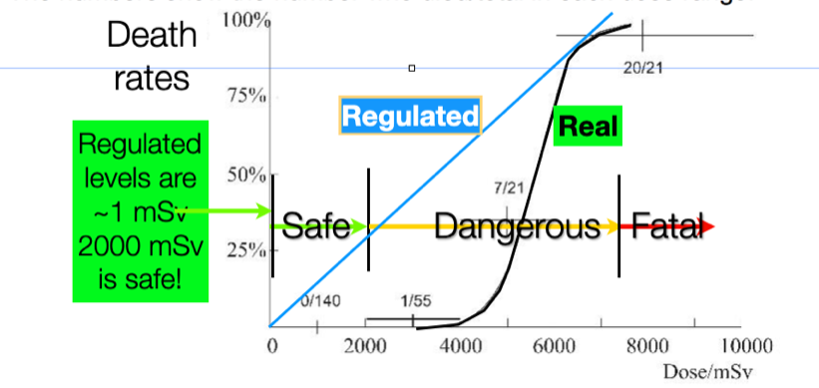
Adopt nuclear power
Nuclear power has proved to be safe, reliable and emissions free
Mass produced small modular reactors will soon be available
Not banned in NZ!

Slide 21
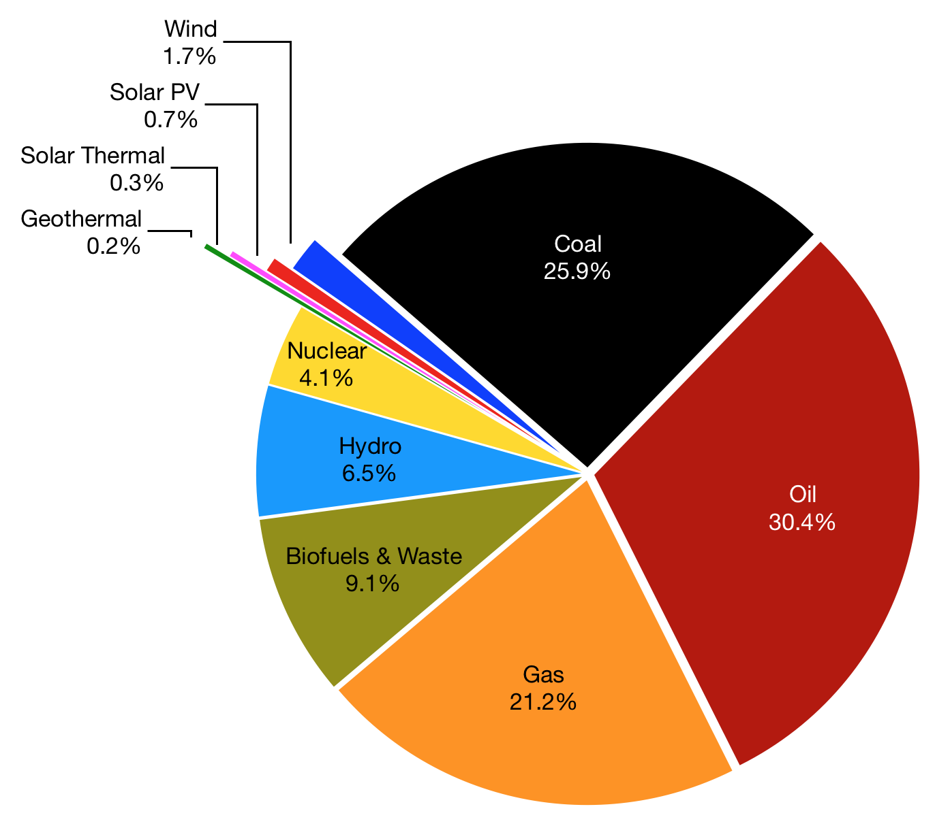
World Energy and Electricity
Wind
Solar
Coal
Oil
Gas

Slide 22
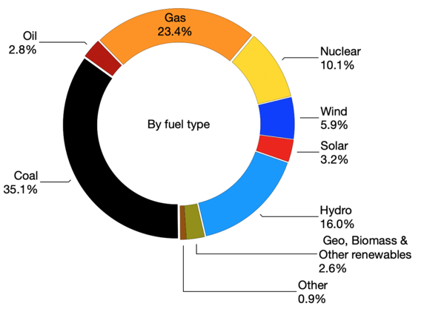
World Electricity
Gas
Wind
Solar
Coal

Slide 23
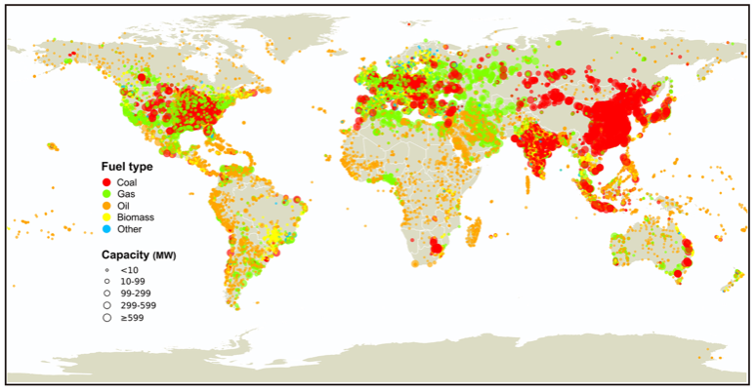
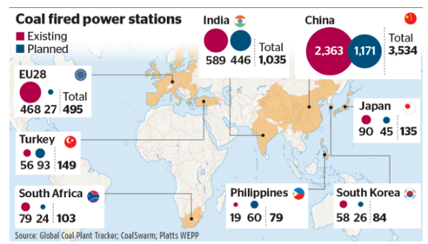
New Zealand cannot affect the climate
Gas fired power plants
Coal fired power plants

Slide 24
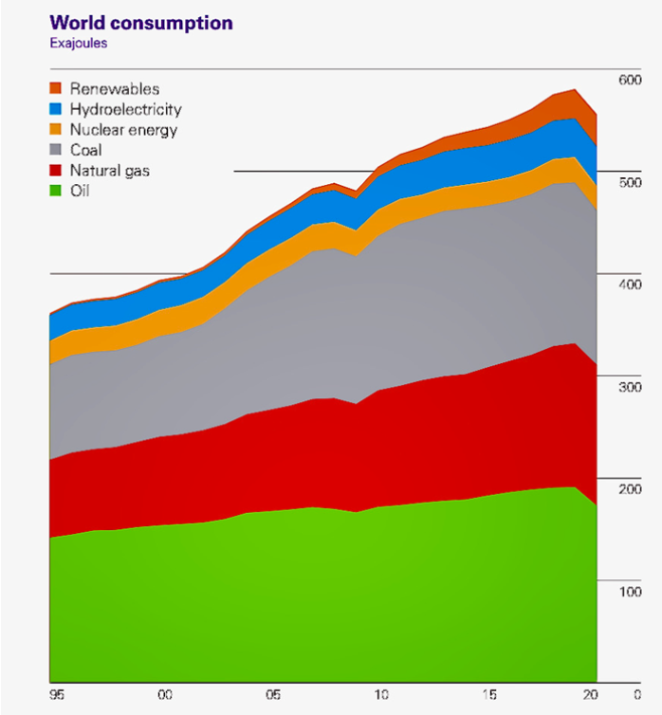
The world runs on fossil fuels!
Renewables
Hydropower
Nuclear
Do we try to mitigate
possibly natural
global warming
or
Do we adapt to
an ever
changing climate?
Coal
Natural gas
Oil
1995
2020

Slide 25
Questions

